Slide 1
Library and Publisher: Key Elements of Cooperation in the Digital Age

Slide 2
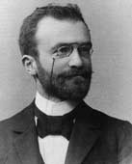
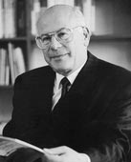
Karger Publishers: A Family Business
Founded in Germany by Samuel Karger in 1890
Managed by the 4th generation of the Karger family
Swiss-based (since 1937), globally active
International organization: 8 regional offices world-wide, local agencies in all 5 continents New: Moscow, Russia
1890 – 2015
125 Years of Experience in Medical and Scientific Publishing
Notes:
Vorschlag esz;
das 125 Years-Logo gibt es ohne Karger nicht

Slide 3
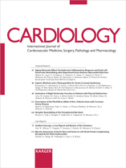
A long history…
Many Karger titles have been published since a long time – well established journals of high reputation in their area serve as a forum for the latest developments and findings of basic and clinical research:
Dermatologische Zeitschrift – Dermatology (1893)
Psychopathology (1897)
Cardiology (1937)
Key Issues in Mental Health (166 vols. since 1917)

Slide 4
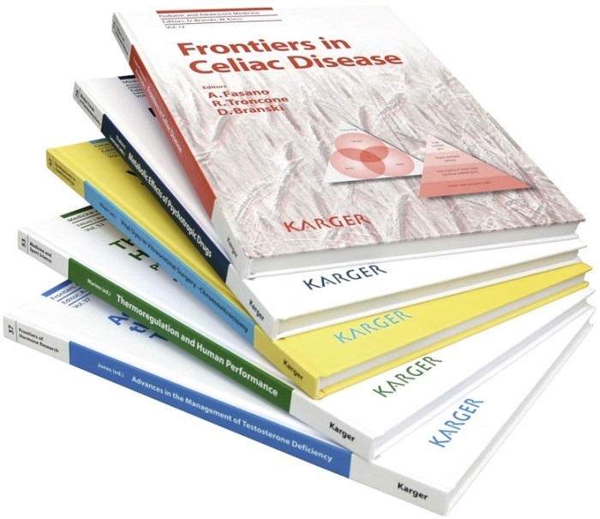
… one focus
Karger is one of the few STM (scientific, technical, medical) publishers with exclusive focus on biomedicine.
Leading international researchers and scientists provide the editorial division with their experience.
All article submissions undergo a rigid peer review process which is organized through our global network of reviewers.
Today, our portfolio comprises all sub- disciplines of human medicine covering basic
as well as clinical research.

Slide 5
Biomedicine - Our Program
100 journals incl. Open Access-titles
40 book series
50 book titles per year
16'000 submitted manuscripts a year
170 Editors-in-Chief and 4'000 Editorial Board Members
12'500 Peer Reviewers

Slide 6
Covering the Spectrum of Biomedicine
www.karger.com/subject
Notes:
Vorschlag esz

Slide 7
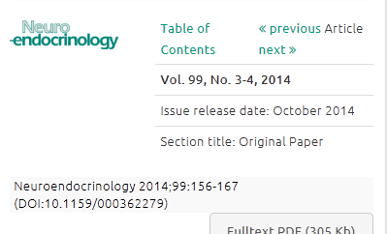
A wide variety of purchasing options
Collection
www.karger.com/Collections/OverviewCollections
Subject Packages
www.karger.com/Collections/OverviewPackages
Individual Titles
www.karger.com/Journal www.karger.com/BookSeries
Article / Chapter
www.karger.com/Info/PPVTerms

Slide 8
for academic institutions
Karger Journals Collection
Karger Journal Backfile Collection
Karger Journal Archive Collection
Karger eBook Serials Collection
Karger eBook Non-serials Collection
New: Karger eBook Archive Collection
Karger Hospital Collection
www.karger.com/Collections/OverviewCollections

Slide 9
for specialized institutions
Selected Karger eJournals and eBooks in one specific discipline:
www.karger.com/Collections/Nutrition
www.karger.com/Collections/Oncology
www.karger.com/Collections/Ophthalmology
www.karger.com/Collections/Pediatrics
New in 2015
www.karger.com/Collections/Nephrology
www.karger.com/Collections/PsychologyPsychiatry

Slide 10
Individual Title Acquisition
Karger Journals:
Subscriptions
Individual Issues
Print, Online or Combined
www.karger.com/Journals
Karger Books:
Series Subscriptions
Individual Books
Print, Online or Combined
www.karger.com/BookSeries
Publishing Highlights 1890–2015
A guided tour through 125 years of medical and scientific publishing
www.karger.com/Publishing-Highlights

Slide 11
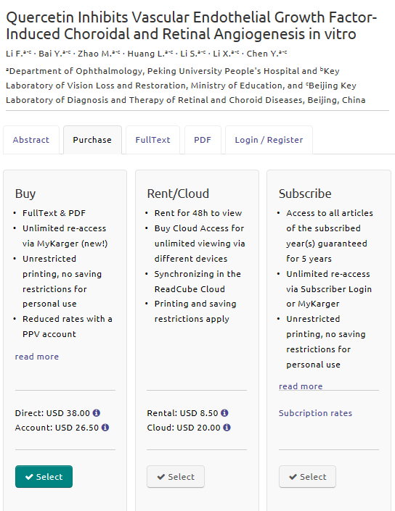
Article- and chapter access options
Karger Pay-per-view
Buy: article/chapter full-text or pdf
Rent/Cloud: for 48 hrs. to view
Coming soon …
Karger Key-word Collections
Article/chapter collections according to key word/field of interest
Combinations of purchasing options are possible

Slide 12
Key Online Features
Searchability Visibility
Accessibility
Administration Customer Service

Slide 13
Searchability/Visibility
www.karger.com
Major Abstracting and Indexing (A&I) Database
MEDLINE/PubMed
Google/Google Scholar
Thomson Reuters Web of Knowledge
ISI Web of Knowledge
Scopus

Slide 14
Searchability/Visibility
Discovery Services
WorldCat Discovery
EBSCO’s EDS
Microsoft Academic Search
Summon
ExLibris Primo Central
Open URL
Google Subscriber Links (for journals)
CrossRef
DOI Numbers

Slide 15
Accessibility
IP controlled; User ID/PW enabled
Remote access options:
VPN
Shibboleth
Athens
Dark Archive: Portico
Mobile device compatible
Digital Rights Management-free
Unlimited simultaneous access
Perpetual access options available

Slide 16
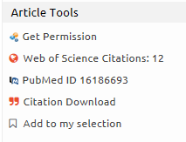
Administration/Customer Service
All content on one platform: www.karger.com
Administrator’s Page
Metadata formats for cataloguing
Counter compliant usage statistics
My Karger - Your Subscriptions - Services for Researchers - Services for Administrators
Personalized service, customized offers
www.karger.com/Services

Slide 17
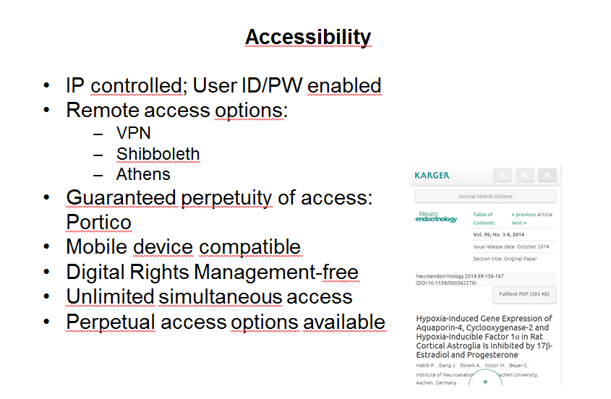
… the decisive factor remains:

Slide 18
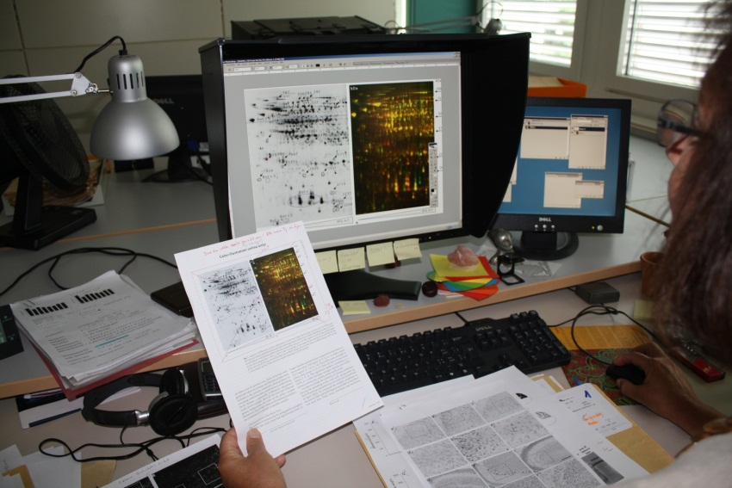
Quality of Content
125 years of experience in biomedical publishing
Extensive network of authors and editors, experts in their field of expertise world-wide
Peer-reviewed, indexed
Highest editing and production standards

Slide 19
Quality of Content: Journal Highlights
Information on human nutrition, metabolism and related fields with a multidisciplinary focus
Presenting experimental studies and basic science as well as observational and interventional studies
Includes reports related to social sciences and health economy / nutrition policy
High visibility among both researchers and users of research outputs, including policy makers
Official journal of : International Union of Nutritional Sciences (IUNS)
Federation of European Nutrition Societies (FENS)
Deutsche Gesellschaft für Ernährung (DGE)

Slide 20
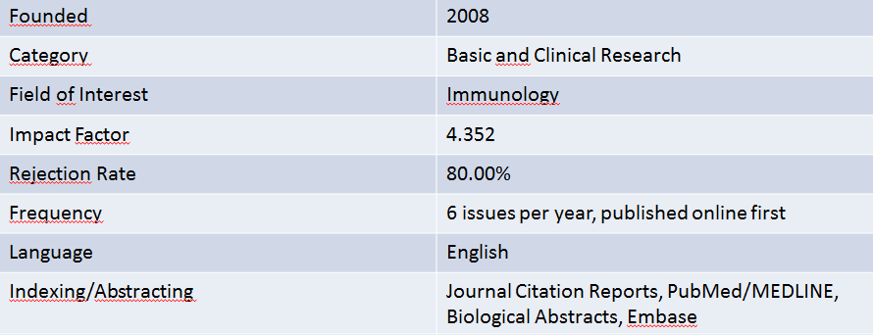
Quality of Content: Journal Highlights
‘The innate immune system is subject to a dynamic and growing scientific exploration. The scope of the Journal of Innate Immunity is to compile and disseminate frontline research. The journal covers the fields from invertebrate to mammalian innate immunity, humoral to cellular immune responses, as well as local versus systemic inflammation.’
Arne Egesten, Editor-in-Chief
evolution of the immune system molecular biology of cells involved in innate immunity, pattern recognition and signals of ‘danger’, microbial corruption, host response and inflammation, mucosal immunity, complement and coagulation, sepsis and septic shock, molecular genomics, development of immunotherapies

Slide 21
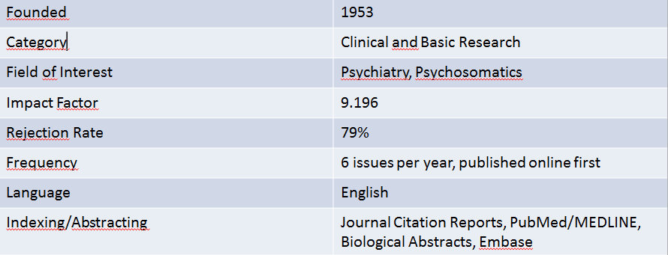
Quality of Content: Journal Highlights
Offers critical views on key clinical issues concerned with assessment and treatment of mental disorders
Reputation for independence, originality and methodological rigor
Anticipates and develops new lines of research in psychosomatic medicine, psychotherapy and psychopharmacology
A unique and vital reference at the heart of innovative thinking and the interface between medical and behavioral sciences
Official journal of : International College of Psychosomatic Medicine
International Federation for Psychotherapy

Slide 22
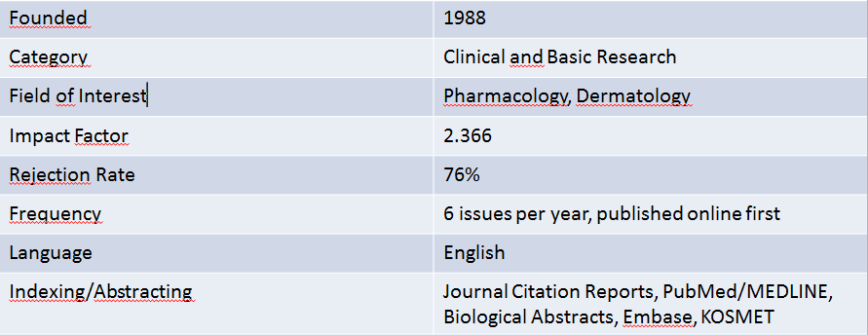
Quality of Content: Journal Highlights
Bimonthly journal covering all aspects within the area of skin pharmacology, including recent ‘hot topics’ such as:
use of nanoparticles for drug delivery in dermatology and cosmetology
use of tissue tolerable plasma in wound treatment
The journal consists of the following sections: original research articles, reviews, short communications, editorials
Official journal of : Journal of the Society for Dermopharmacy /
Gesellschaft für Dermopharmazie e.V. (GD)

Slide 23
20 Open Access Journals
Maximizing visibility and impact of research work
Accelerated publishing time
Peer-reviewed, premium quality in layout and copy-editing
Standard-License is CC-BY-NC-ND
Searchable in PubMed, Impact Factor
Open Access perpetuity guaranteed through dark archives
Special tailored Open Access publishing agreements for special needs of institutions or funding bodies
Discounts on Open Access Article Processing Charges available to academic customers
www.karger.com/OpenAcces

Slide 24
International References – Worldwide Consortia
Karger content at leading medical academic universities and consortia world-wide
ANKOS, Turkey
Bibsam, Sweden
Bibliosan, Italy
CAPES, Brazil
CEIRC, Australia
CDL (California Digital Library), USA
Couperin, France
Czech Consortium, Czech Republic
DRAA, China
DFG, Germany
Icelandic Consortium, Island
JISC, United Kingdom
JMLA, Japan
KESLI, Korea
MALMAD and MERAV, Isreal
MLG, Malaysia
NERL, USA
National License Agreement with NSTL, China (Journal Archive Collection)
Thai Medical School Consortium
UKB, The Netherlands
Swiss Consortium
Polish Consortium
Qatar Foundation

Slide 25
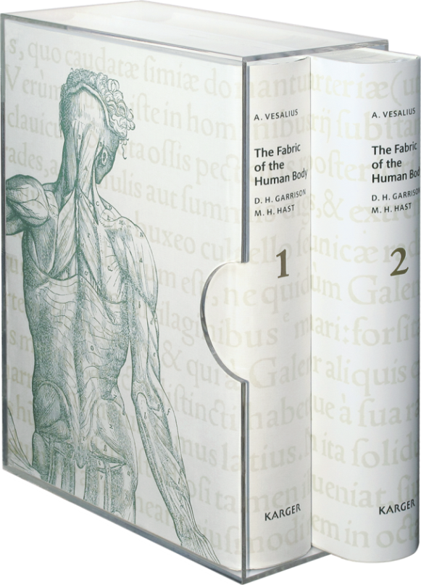
Information in Russian in the
Scholarly Communication Review:
www.editorialboard.ru/blog/common/1733.html
www.vesalius-fabrica.com
Notes:
The Fabric of the Human Body encompasses over 1,400 pages in two books, hard cover with slip case, 315 × 435 mm, weighing approx. 16 kg

Slide 26
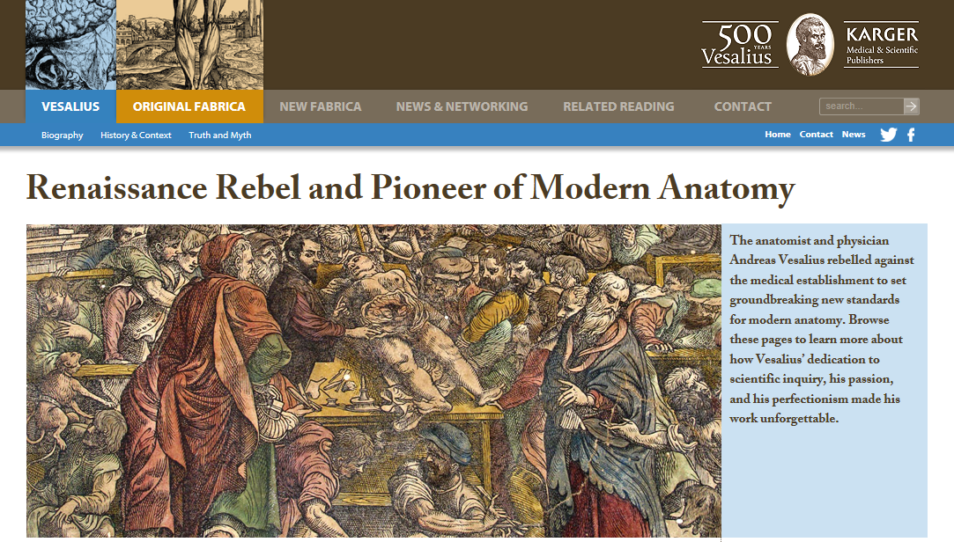
Notes:
Vesalius sparked a scientific revolution with a magnificent book of anatomical instruction and famous illustrations, De humani corporis fabrica, that modernized the field of anatomy. This English translation and its fresh reconstructions of Vesalius’ sublime illustrations make Vesalius truly accessible in English for the first time. It is presented in an innovative, easy-to-use design.

Slide 27
Thank you for your attention!
Contacts
S. Karger Publishers, Basel
Moritz Thommen
Director of Sales
m.thommen@karger.com
0041 61 306 1396 www.karger.com
World of Periodicals, Moscow
Olga Timofeeva
Commercial Director
otimofeeva@mperio.ru
0499 943 96 93 www.mperio.ru

Slide 28
Medical and Scientific Publishers
since 1890
Contact Information
Moritz Thommen
Sales Director
m.thommen@karger.com

