Slide 1
Emerald eBook Collections Research at your Fingertips
www.emeraldgrouppublishing.com/products/ebooks

Slide 2
At Emerald Publishing our aim is to help research and researchers make an impact

Slide 3
Emerald has invested in a major new programme of academic and professional books publishing
Emerald has published books since 2007. With a portfolio of more than 2,500 books, and over 150 new titles publishing each year, we provide high quality, cutting-edge research across a range of subjects.
Emerald has invested in a major new programme of academic and professional publishing designed to bring the very latest ideas and approaches to global universities, researchers, students and practitioners.
Our books add depth to research and learning, featuring ground-breaking research, case studies and advice from global thought leaders, helping to drive change in their field.

Slide 4
Book Series and Serials
In 2007 Emerald Publishing acquired a collection of book series, strengthening our expansion into book publishing and the field of social sciences.
These book series and serials formed the cornerstone of Emerald’s book portfolio, featuring a wide range of notable, well established titles for scholars, academics, researchers and professionals.
Providing more in-depth and comprehensive analysis than found in academic journals, the series add depth to research and learning.
Over time Emerald Publishing has grown the books programme, publishing more "standalone" titles outside of the serials and in 2016 we have launched a new books publishing programme, with the intention to grow the portfolio considerably.
We are delighted that, from the end of 2016 the eBook collections contain scholarly monographs, edited collections, handbooks and professional texts and now include our complete books publishing programme, in addition to series.

Slide 5
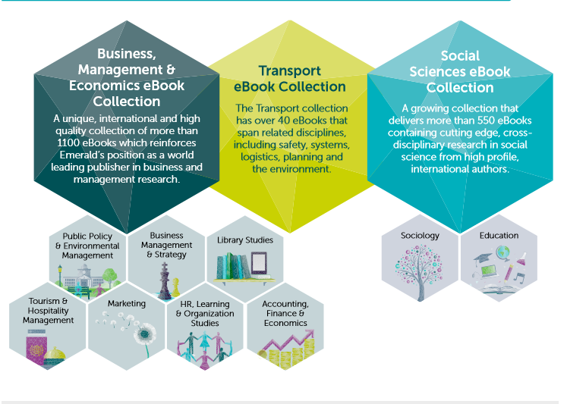
eBook Collections

Slide 6
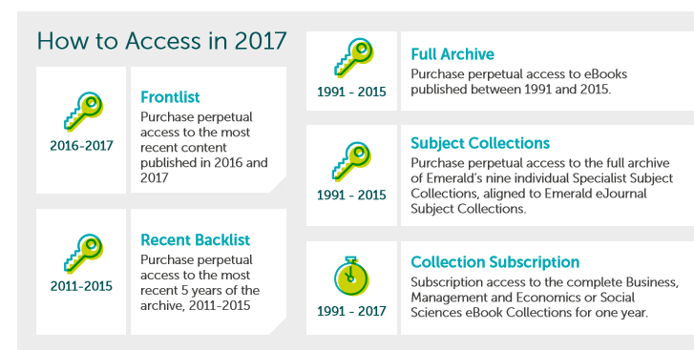
How to Purchase

Slide 7
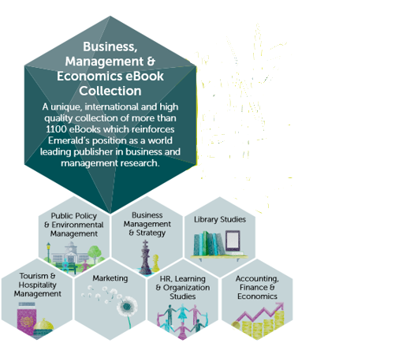
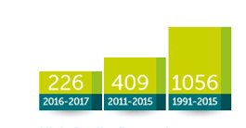
Business, Management & Economics eBook Collection
Demonstrating measurable research impact, Emerald Business, Management and Economics eBook Collection is a fast growing portfolio that contains over 1150 monographs, edited collections, handbooks and professional texts and includes our complete books publishing programme, in addition to series.
Featuring high impact and topical research, these titles offer an in-depth and comprehensive analysis of the subject areas. High profile, international authors deliver cutting-edge, cross-disciplinary research in Business, Management and Economics.

Slide 8
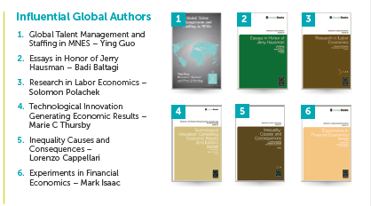
Business, Management & Economics eBook Collection
Over 85% of series in the collection have volumes indexed in the Book Citation Index (BKCI)
90% of series in the collection have volumes indexed in Scopus
One eBook series is ranked in the Journal Citation Reports Social Sciences Citation Index

Slide 9
Social Sciences eBook Collection
Emerald Social Sciences eBook Collection is a fast growing portfolio that contains over 650 monographs, edited collections, handbooks and professional texts and includes our complete books publishing programme, in addition to series.
This collection covers the major topics across the Education, Political Science and Sociology disciplines from recognised authors in the field.

Slide 10
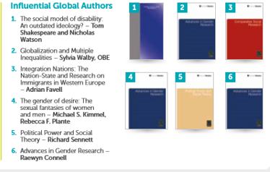
Social Science eBook Collection
Over 80% of series in the collection have volumes indexed in the Book Citation Index (BKCI)
90% of series in the collection have volumes indexed in Scopus
Two eBook series are ranked in the Journal Citation Reports Social Sciences Citation Index

Slide 11
Transport eBook Collection
49 eBooks, spanning a wide range of transport disciplines. With several titles featured in the book citation index, and contributions from leading global experts this collection provides an essential resource for universities, government departments and ministries, research centres and other organizations focusing on transportation.

Slide 12
New for 2017 Subject Collection

Slide 13
Features and Benefits

Slide 14
For further information about
eBook Collections please contact
your regional representative

Slide 15
QUESTIONS? COMMENTS?
cmazzoleni@emeraldgroup.com

