Slide 2
At Emerald Publishing our aim is to help research and researchers make an impact

Slide 3
The simple and flexible approach to building your collection
eJournals Premier provides access to the full breadth of Emerald’s eJournal content
Tailor resources with a dedicated eJournal Subject Portfolio or eJournal Subject Collections.
Notes:
Portfolio of Emerald eJournal Collections.
Emerald Premier
Emerald Management collections: 9
Emerald Specialist collections: 4

Slide 4
eJournals Premier
A complete eJournals solution
The most comprehensive, unified offering – combining the Management and Specialist Portfolios, this premium collection provides access to the full breadth of Emerald’s eJournal content
Maximum value – over 160,000 articles from more than 300 journals by the end of 2017
Latest research – Article output is closely mapped against research trends so that we produce more articles in those areas of current or rapidly emerging interest.
Notes:
Here you can see in detail the subject áreas we actually cover in our journal collections.
We currently have more tan 160,000 articles in more tan 300 journals, which include the latest research in the different áreas – Up to date content!

Slide 5
Management eJournal Portfolio
Leading the field of management research
Emerald has a strong heritage in management research. Long recognized as a leader in this field, the breadth of our collection ensures that we continue to provide a premier resource for students, researchers and business practitioners studying and working in this area.
Notes:
Some examples of the titles included in our management collections: Ex. European Journal of Marketing, our flagship title in the Marketing collection

Slide 6
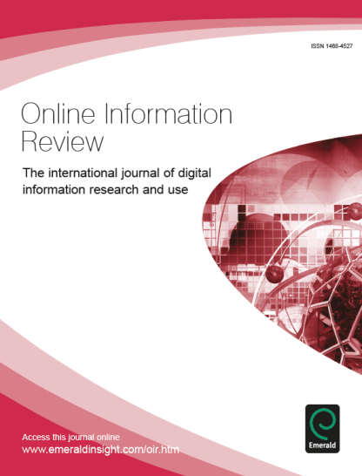
Specialist eJournal Portfolio
Dedicated to extending the niche
Designed to complement and extend our strength in management, Emerald has diversified its
offering by publishing high-quality research dedicated to subject community development,
Emerald’s Specialist eJournal Collections provide access to the latest, topical research in your field.
Notes:
Same in the speciallist collections!

Slide 7
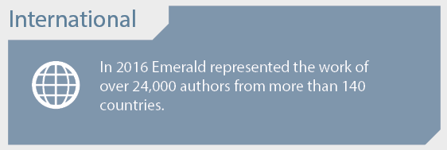
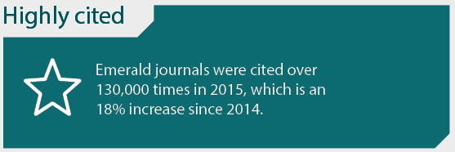
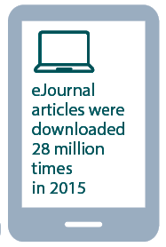
High quality, usable research
Notes:
Some facts!
-All our content is double blind peer reviewed, this speaks about the high quality of the content we publish
-We have contributors from World´s top 100 Business schools arround the world
-International research: 24,000 authors from more than 140 countries
-Highly cited

Slide 8
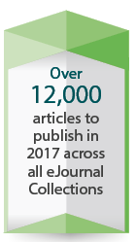
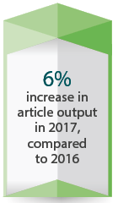
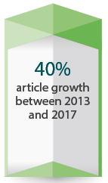
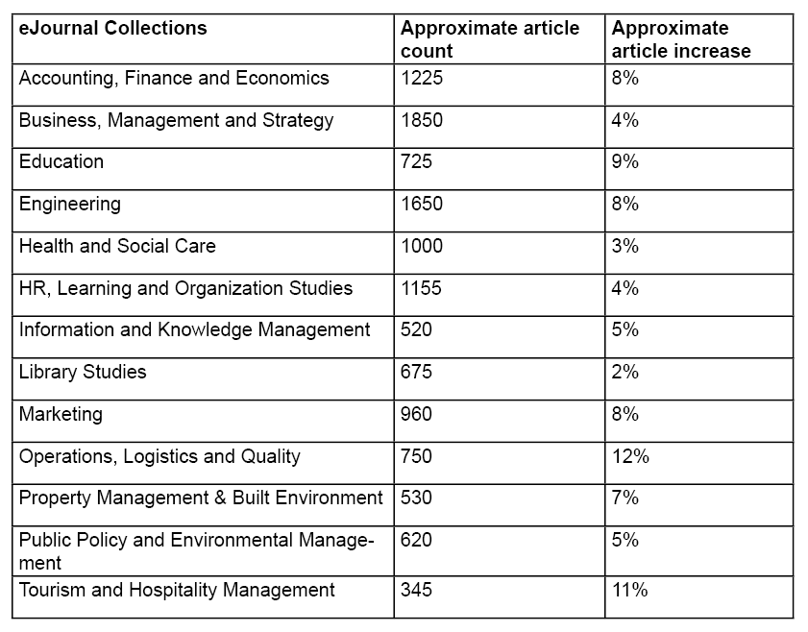
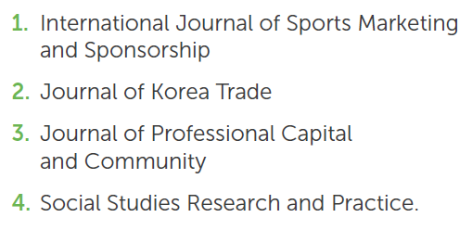
Continuous growth
Notes:
We keep on growing!!!

Slide 9
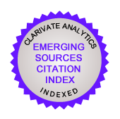
Highly ranked
Over 260 Emerald journals are listed in Web of Science™
90% of journals indexed in the Journal Citation Reports® increased their number of citations in 2015
Emerald outperformed the market with 72% of our indexed titles seeing an increase in their Impact Factor for 2015
Journals listed in the Journal Citation Reports® span over 40 different subject areas
In 2015 six journals received Impact Factors above 2.000, which is double the number from the 2014 release
Over 190 of Emerald journals are listed in the Emerging Sources Citation Index.

Slide 10
Highly ranked
Emerald has over 350 titles with a 2015 CiteScore
Over three quarters of our content in business, management and accounting is in quartile one and two
Over half of our content in social sciences, engineering and economics and econometrics and finance is in quartile one and two
270 (88%) of Emerald journals are indexed by Scopus
Continuously growing the number of indexed titles, with a 16% increase from 2014 to 2016
19 of our titles are in the top decile (the most highly cited 10%) of their respective subject areas

Slide 11
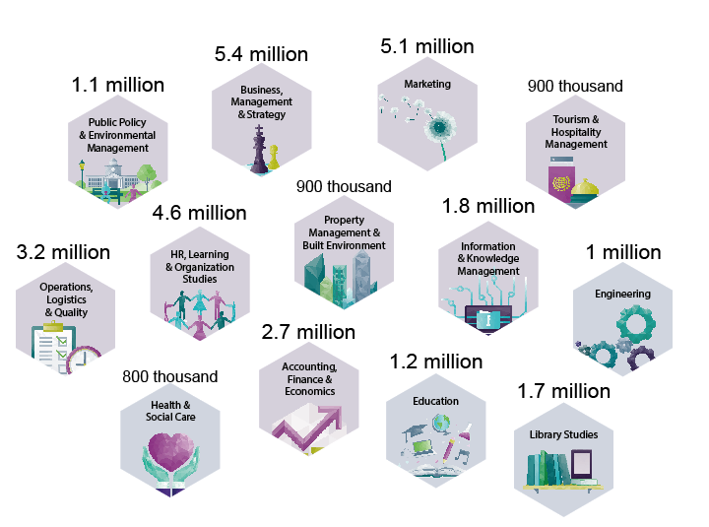
Highly used
Over 30 million article downloads for 2017

Slide 12
What does a subscription include?
^{Complimentary access}
Users will receive complimentary access to selected archive content for the duration of a live subscription.
^{Access in perpetuity}
Perpetual access to content published during our subscription period, even if you stop subscribing.

Slide 13
www.emeraldinsight.com A dedicated research platform

Slide 14
More information
eJournal subject information pages
www.emeraldpublishing.com/ejournalscollections
Contact your Emerald representative
www.emeraldpublishing.com/offices

Slide 15
QUESTIONS? COMMENTS?
cmazzoleni@emeraldgroup.com

