Slide 1
eCase Collection Challenge students with authentic case studies from mature and emerging markets
http://www.emeraldinsight.com/page/casestudies

Slide 2
At Emerald Publishing our aim is to help research and researchers make an impact

Slide 3
Case studies provide students with simulated decision making experience
1
2
3
4
INDIVIDUAL
CASE
PREPARATION
TEAM
ANALYSIS
AND DEBATE
CASE
DISCUSSION IN
CLASS
CONCLUSIONS
DRAWN AND
LESSONS
LEARNED
Management education prepares and refines students’ abilities to make more considered decisions, often with incomplete information and increased complexity. Well-researched case studies designed to facilitate robust managerial analysis and debate are therefore important educational tools. Teaching through the case method has been shown to increase student engagement, encourage collaboration and reflection, and importantly application of learning.
Dr. Michael Goldman, Assistant Professor, University of San Francisco, USA

Slide 4
Emerald has published case studies for use in teaching since 2011
Emerging Markets Case Studies Local insight with global relevance
Arm graduates with authentic examples of organisational challenges within emerging markets, and inspire strategies designed to tackle business problems of the future. This collection introduces captivating commercial scenarios, authored by academics specialising in developing economies.
The CASE Journal The official journal of the CASE Association
Present students with a modern interpretation of discussion based teaching, and equip the next generation of business professionals with the acumen to solve strategic problems in enterprise. This double-blind, peer-reviewed collection is endorsed by The CASE Association, who nurture authors to craft quality case research, and promote case studies as the catalyst for powerful classroom discussion.

Slide 5
Emerging Markets Case Studies authors work in or with developing economies

Slide 6
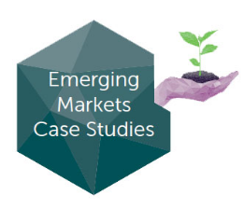
Emerging Markets Case Studies
Launched in 2011 by Emerald Publishing
A collection of peer-reviewed teaching cases focusing on business decision making and management development through key emerging markets.
Cases are written by authors working in or closely with developing economies, offering local perspective with global appeal.
Includes c500 Case Studies.
Emerald Emerging Markets Case Studies provides
well-researched, instructive, and multimedia online
cases about organizational challenges within developing economies and inspires strategies designed to tackle the business problems of the future.
Available by subscription with perpetual access to the
content published during the subscription period.

Slide 7
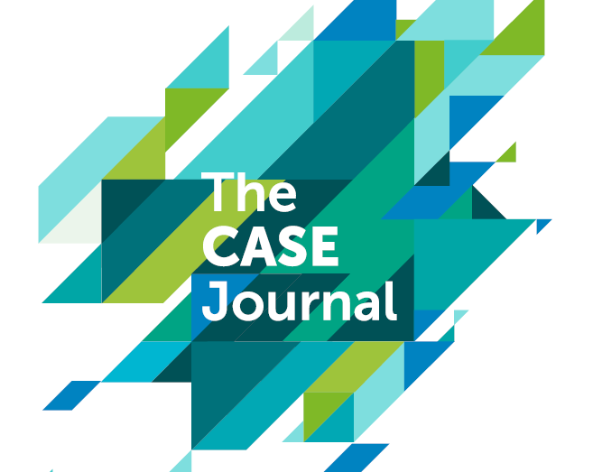
A modern interpretation of discussion based teaching, endorsed by The CASE Association

Slide 8
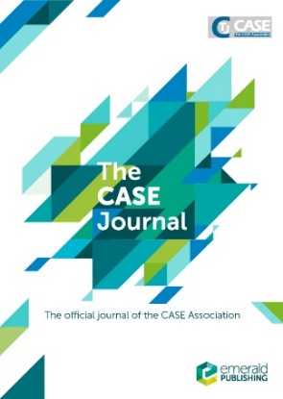
The Case Journal
Launched in 2004 and published by Emerald since 2012
The official journal of The CASE Association, who nurture authors to craft quality case research.
TCJ is the leading, online, double-blind, peer-reviewed journal featuring factual teaching cases and case exercises spanning the full spectrum of business and management disciplines. It also includes examples from a range of small-medium and large companies.
TCJ offers authors the chance to work collaboratively with a team of expert reviewers and the Editor-in-Chief to develop their case study into its best possible form.
Includes not only teaching cases but also articles addressing the case method of instruction and research.
Teaching notes are available for educators.
Available through annual subscription with perpetual access to content published during the subscription period.

Slide 9
The Case Journal
With the rise of experiential learning, cases studies remain a fundamental teaching tool in every subject area within the business school discipline. Cases are a critical component to any business school curriculum.
As a developmental organization the CASE Association advocates case writing and case teaching and prides itself in providing a forum for both novice and seasoned case writers.

Slide 10
60%
84%
WRITE CASE
STUDIES
OF TEACHING FACULTY
USE THE CASE
METHOD
50%
18%
UNAWARE IF CASE
IS TAUGHT
BY OTHERS
INSTITUTIONAL
REPOSITORY
On average, those using the case method are working with 6 cases per course

Slide 11
New for 2017

Slide 12
What is the eCase Collection?
Provides teaching faculty with unlimited use of international business cases, through an annual subscription, no matter the classroom size. Complementing our own case library, the collection also features teaching material licensed from global case method advocates, and enables tailored discussion based on student experience, expectation and capability.
Case Studies on a dedicated platform which also provides journals and books content for deeper reference, and teaching
With one annual subscription introduce real world business scenarios to your classroom with the Emerald eCases collection.
Manage your spend, and provide faculty with greater choice by offering unrestricted access to a digital library of over 1500 teaching cases from both emerging and mature economies, incorporating content from some of the world’s most highly regarded business schools.
All available, and easily searchable on EmeraldInsight.com

Slide 13
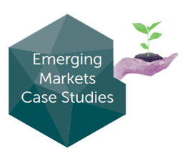
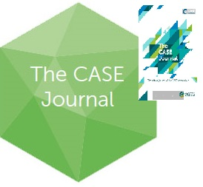
What is in the eCase Collection?
Authentic business scenarios for the classroom
Arm graduates with authentic examples of organisational challenges within emerging markets, and inspire strategies designed to tackle business problems of the future. This collection introduces captivating commercial scenarios, authored by academics specialising in developing economies.
Present students with a modern interpretation of discussion based teaching, and equip the next generation of business professionals with the acumen to solve strategic problems in enterprise. This double-blind, peer-reviewed collection is endorsed by The CASE Association, who nurture authors to craft quality case research, and promote case studies as the catalyst for powerful classroom discussion.
Case studies have been licenced from leading international business schools to complement Emerald’s existing case portfolio. Content from the Darden School of Business, University of Virginia, and the Kellogg School of Management, Northwestern University, spans the MBA curriculum from accounting to strategy, creating dynamic and effective opportunities for students to understand and apply business theory, analyse complex situations, and formulate solutions.

Slide 14
The eCase Collection
Challenging students with authentic case studies from emerging and mature economies
The digital library with faculty restricted access to teaching notes and supplementary resources

Slide 15
A Single Annual Subscription that provides unlimited access to a growing digital library
Librarian
Faculty
One annual subscription
Traditional Route (Pay per view)
Emerald eCase Collection
Choose case from PPV supplier
Choose case from digital library
Repeat annually for each case
Work out no. of students in course
Time saved
Pay £ per case x no. of students
Send link to students / LMS
Send link to students / LMS
Teach Case

Slide 16
Benefits for librarians
A digital library with a single subscription for your institution, Emerald eCase Collection will significantly enhance your offering to students and faculty whilst giving central control of budget
12 month subscription access to the full and growing collection of over 1500 case studies
Unlimited access across subscribing institutions for students and faculty
eCases are accessed alongside other content on Emerald Insight, enhancing discoverability
New cases added throughout the year.

Slide 17
Benefits for Faculty
Prepare students for business by making resources for the case method easier to access
Browse content by Case Origin, Subject, Publisher and Date
Simply select a case study of interest and send the link to your students or add to your LMS/VLE
Online teaching notes are restricted to institutional teaching faculty
As well as teaching notes, supplementary
material and exercises are available for
many case studies.

Slide 18
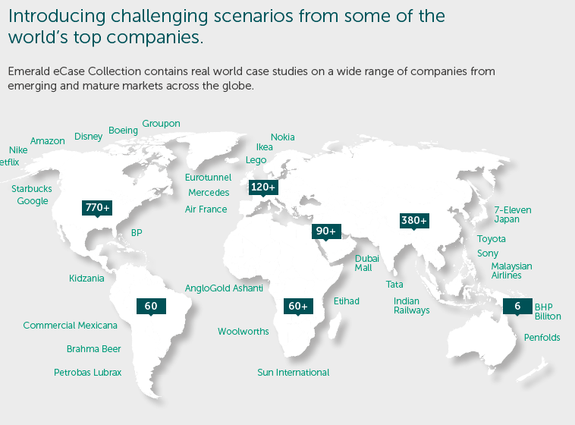
Content: Regional Coverage

Slide 19
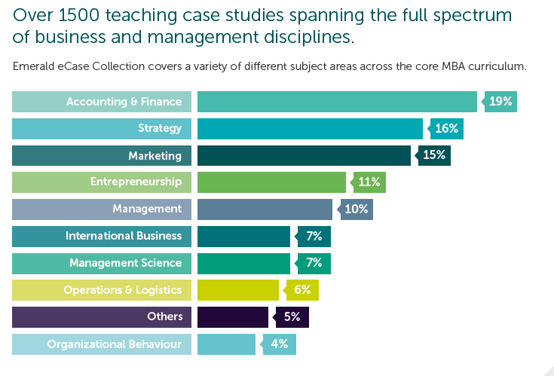
Content: Subject Areas

Slide 20
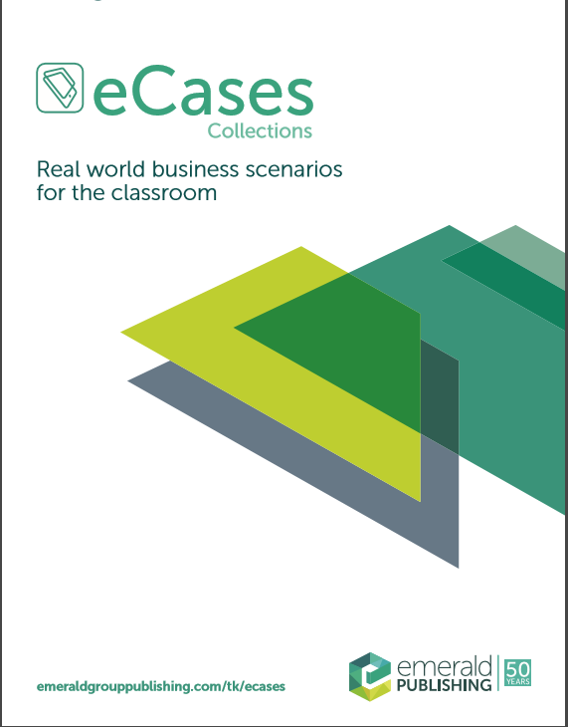
For further information about
eCase Collection please contact
your regional representative:

Slide 21
QUESTIONS? COMMENTS?
cmazzoleni@emeraldgroup.com

