Slide 1
Mobile Learning Solutions
Embracing the mobile future
May 2017

Slide 2
My Learning
THE CROSSKNOWLEDGE MOBILE LEARNING EXPERIENCE
The answer to the mobile learning challenge

Slide 3
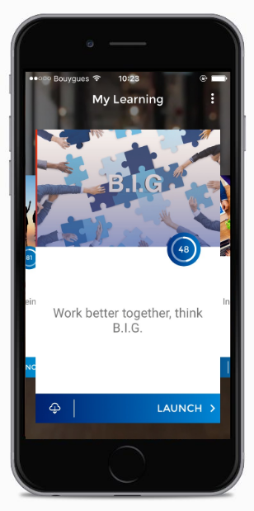
Your customized mobile university
Designed for mobile-first use.
Access all your mobile courses online.
Download resources and view them offline.
Fully customizable to your brand.
3

Slide 4
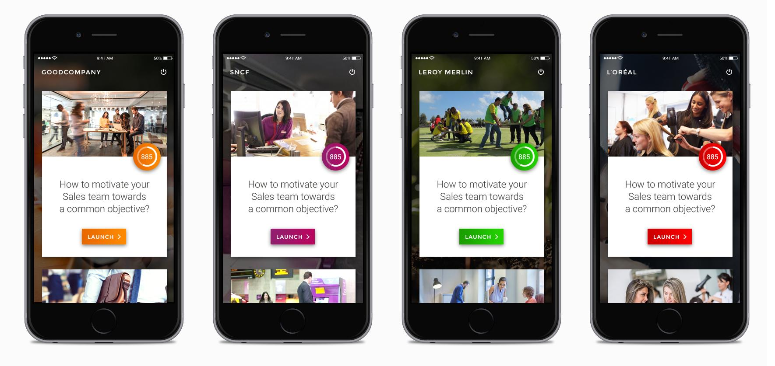
Customizable to your main colors and embedding all your learning initiatives
4

Slide 5
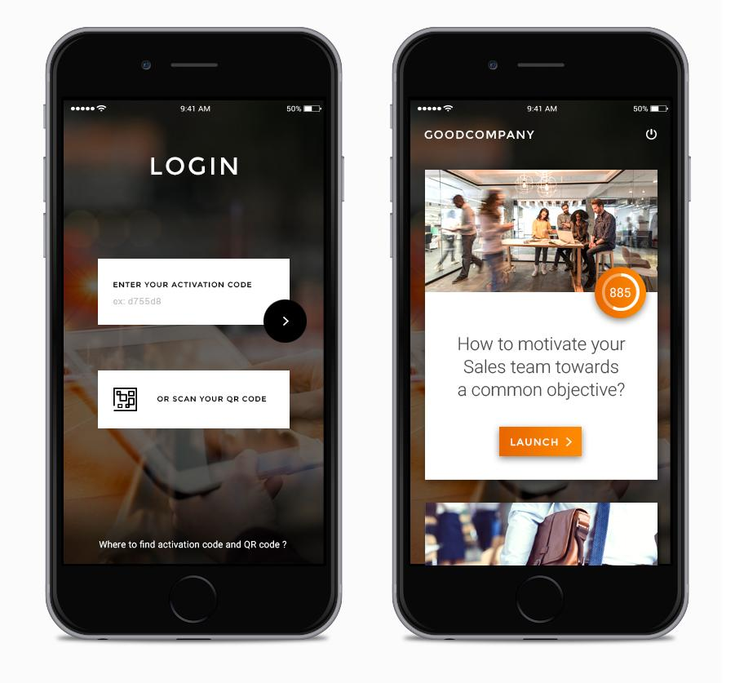
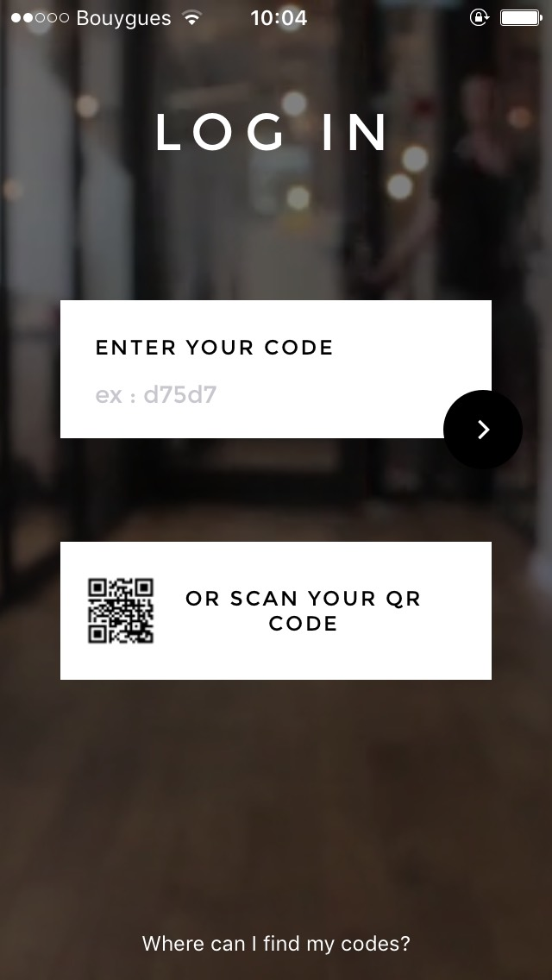
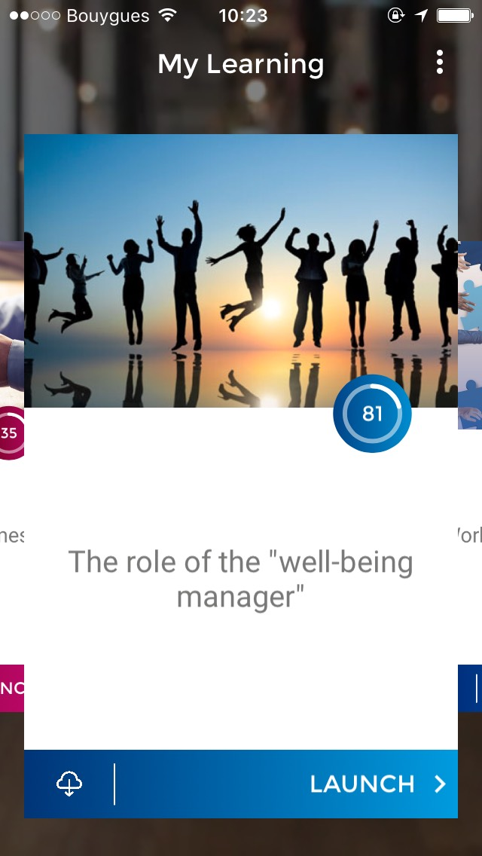
Discover My Learning
Browse & Search
Easily search for your course and launch it.
Easy Access
Enter or scan your code and enjoy the native Mobile Learning experience.

Slide 6
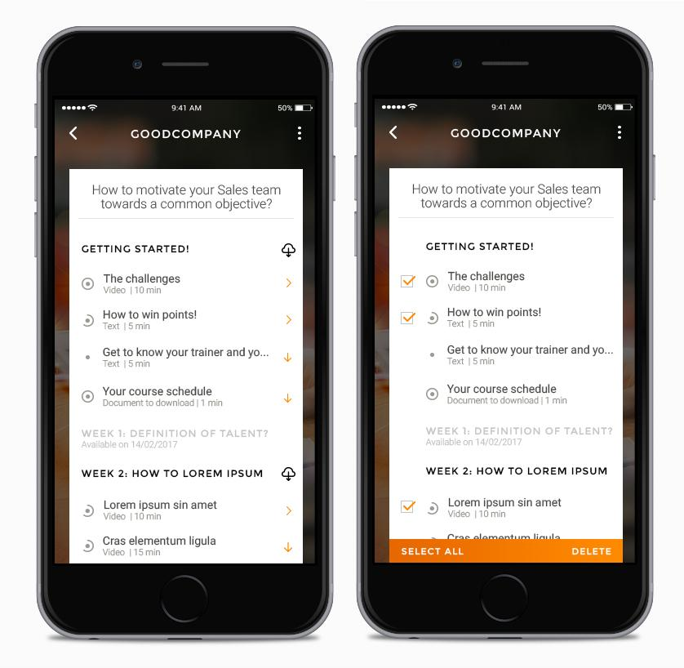
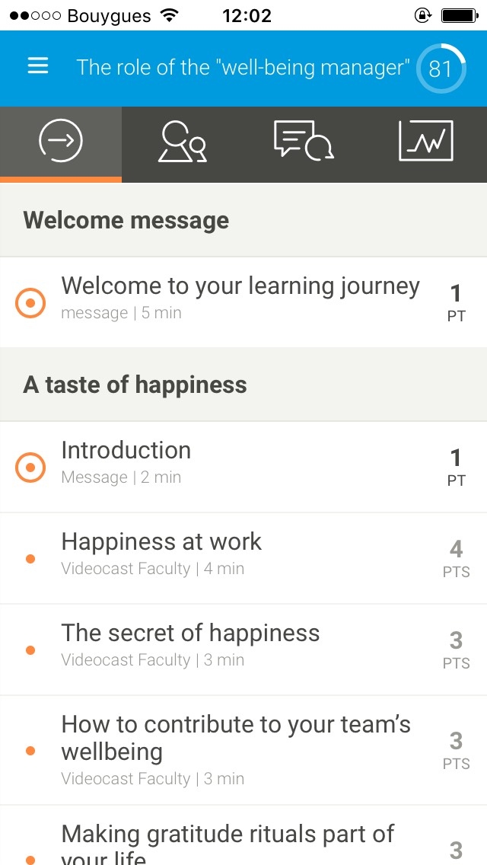
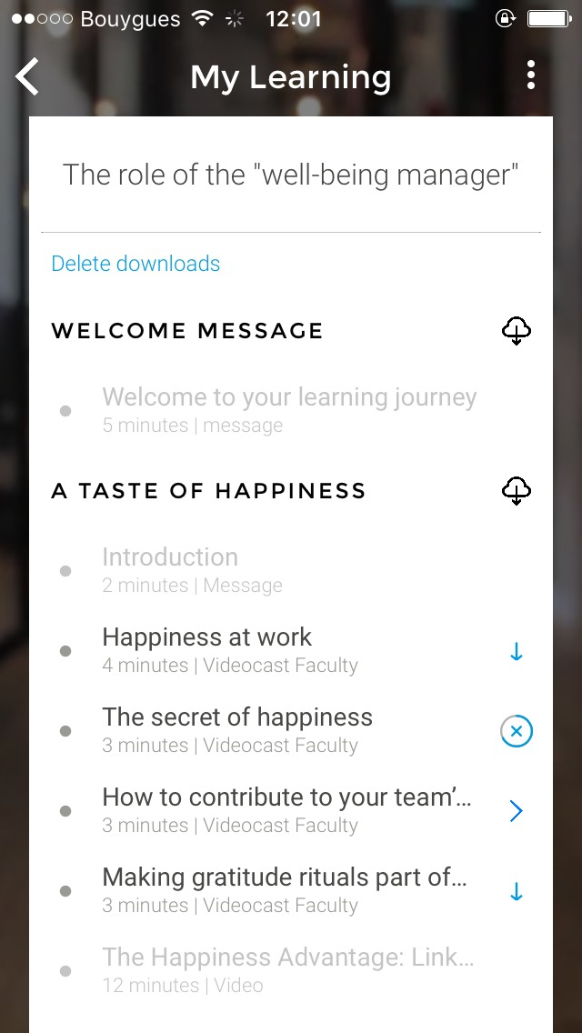
Track your progress at every step of the way
Download courses
Download courses to view them offline. Reconnect later and get your score synchronized.
View download status
Track progress
View topics finished and earn points.
Access downloaded courses
6

Slide 7
My Learning
STEP BY STEP ACCESS GUIDE
Access My Learning from the platform

Slide 8
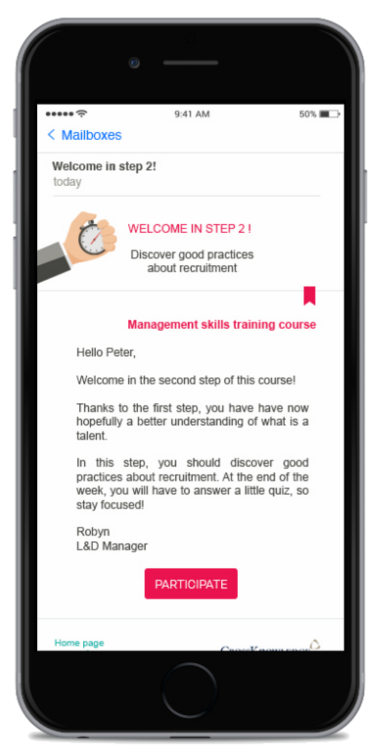
Step 1
Course e-mail
Learner receives an email at the beginning or while completing a step in the course.
The email invites the learner to PARTICIPATE to the course.
8

Slide 9
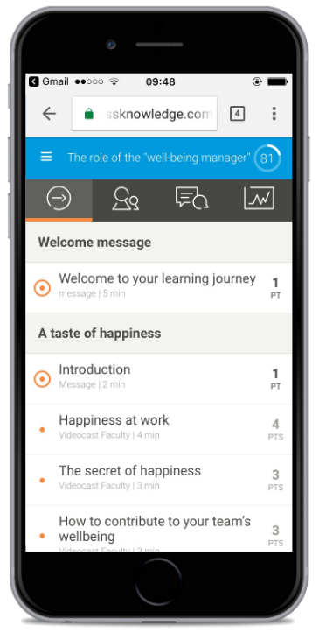
Step 2
Course accessibility
Learner accesses the course via his device browser (desktop or mobile).
Learner navigates through the course.
9

Slide 10
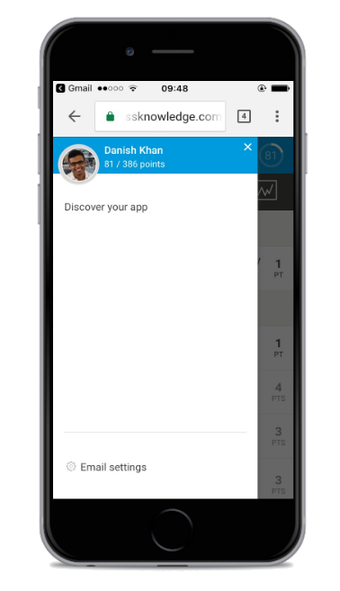
Step 3
App discovery
Learner is invited to try the new app from the menu.
10

Slide 11
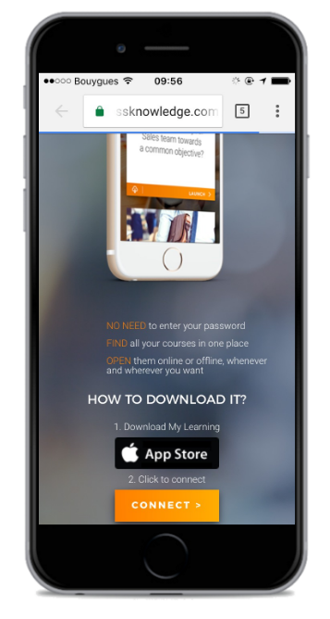
Step 4
Download
Learner gets the download link and downloads My Learning.
My Learning is available in iOS (App Store) and Android (Play Store).
11

Slide 12
Browse and Launch
Once logged in, the learner can easily browse through all their mobile courses.
The learner stays logged in and will not be asked for his credentials every time he uses the app.
12

Slide 13
Learning Suite Mobile strategy
Blended Learning
Classic access
Classic Portal Page
100% Distance learning
Web Mobile access
Mobile Portal Page
Blendedˣ
App My Learning
Welcome screen
Learning Channel
Notifications / Offline viewing
New formats
Web static design
Web Adaptive design
App design
13

