Slide 1
Wiley Researcher Academy
Updates April 2018

Slide 2
New Navigation

Slide 3
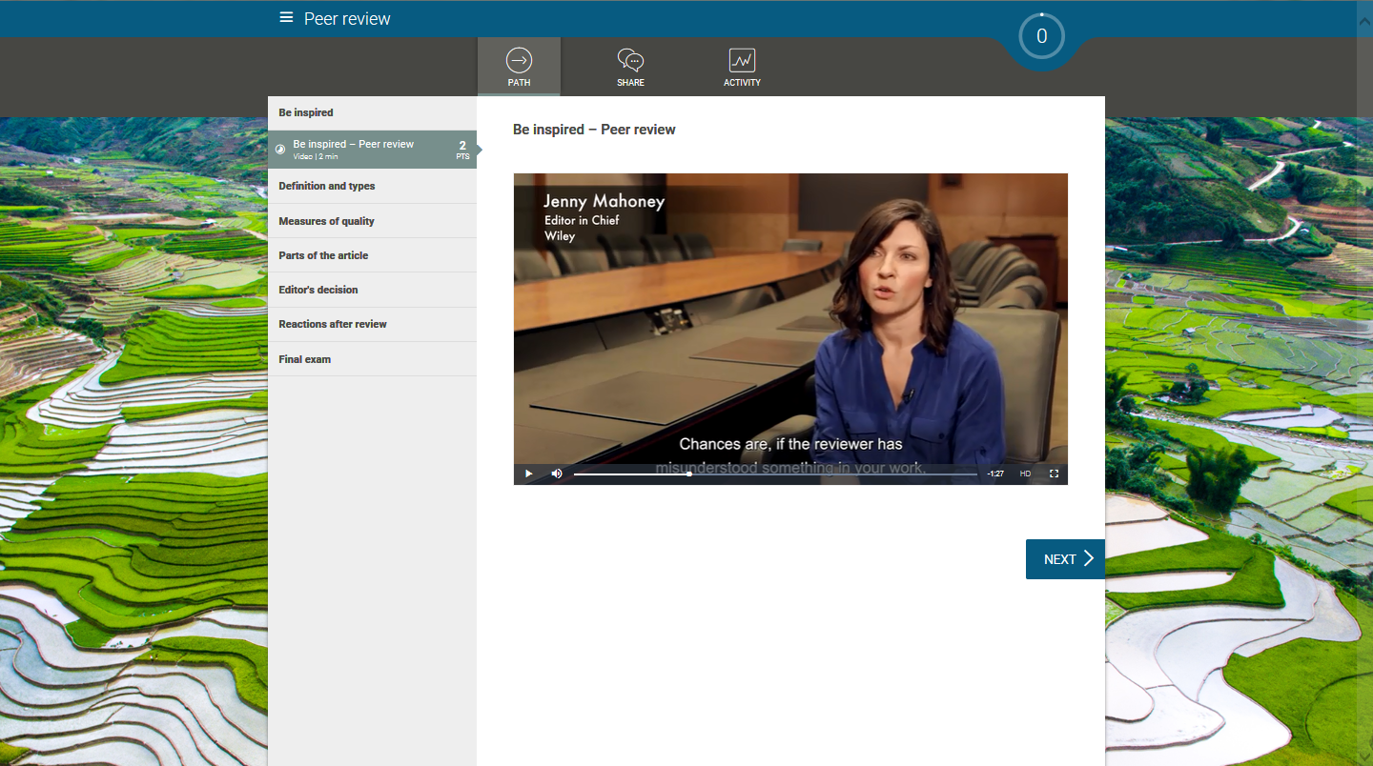
Simple and intuitive interface
Notes:
Simple navigation. Easy to use!
Learners understand quickly how it works, because of its simplicity.

Slide 4
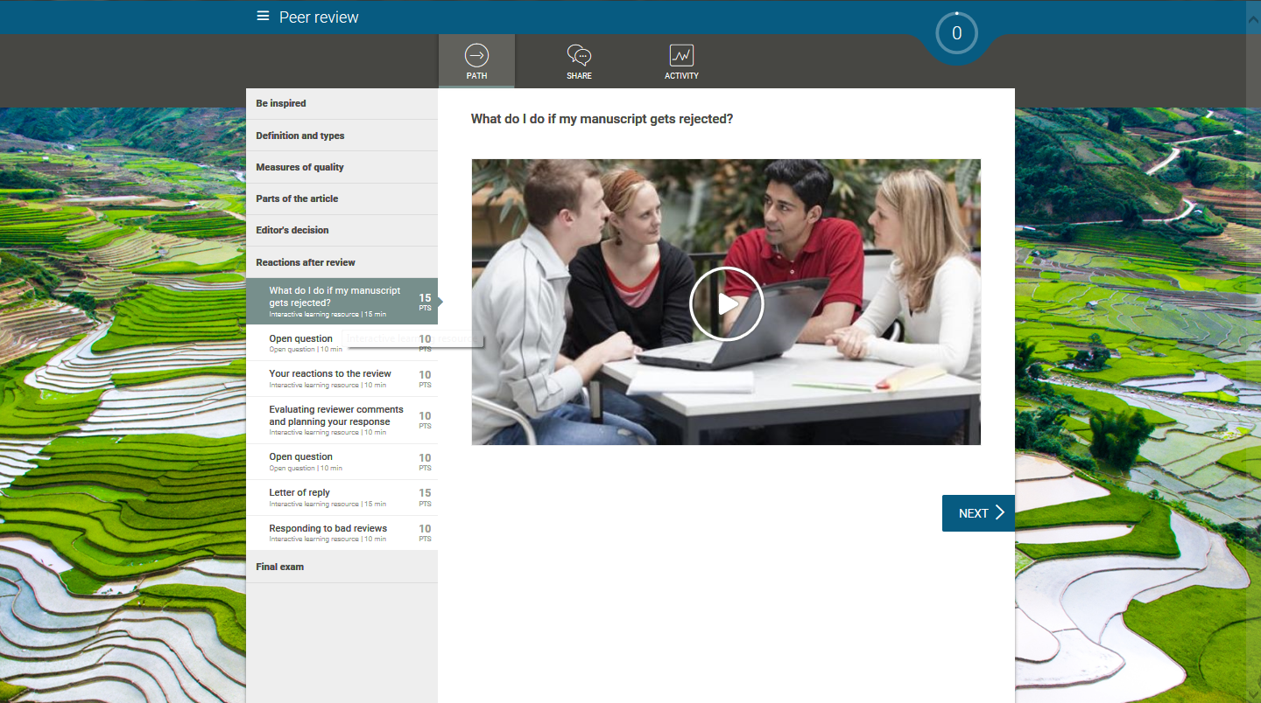
Vertical menu within each Learning Path
Notes:
Logical and Ergonomic Organization

Slide 5
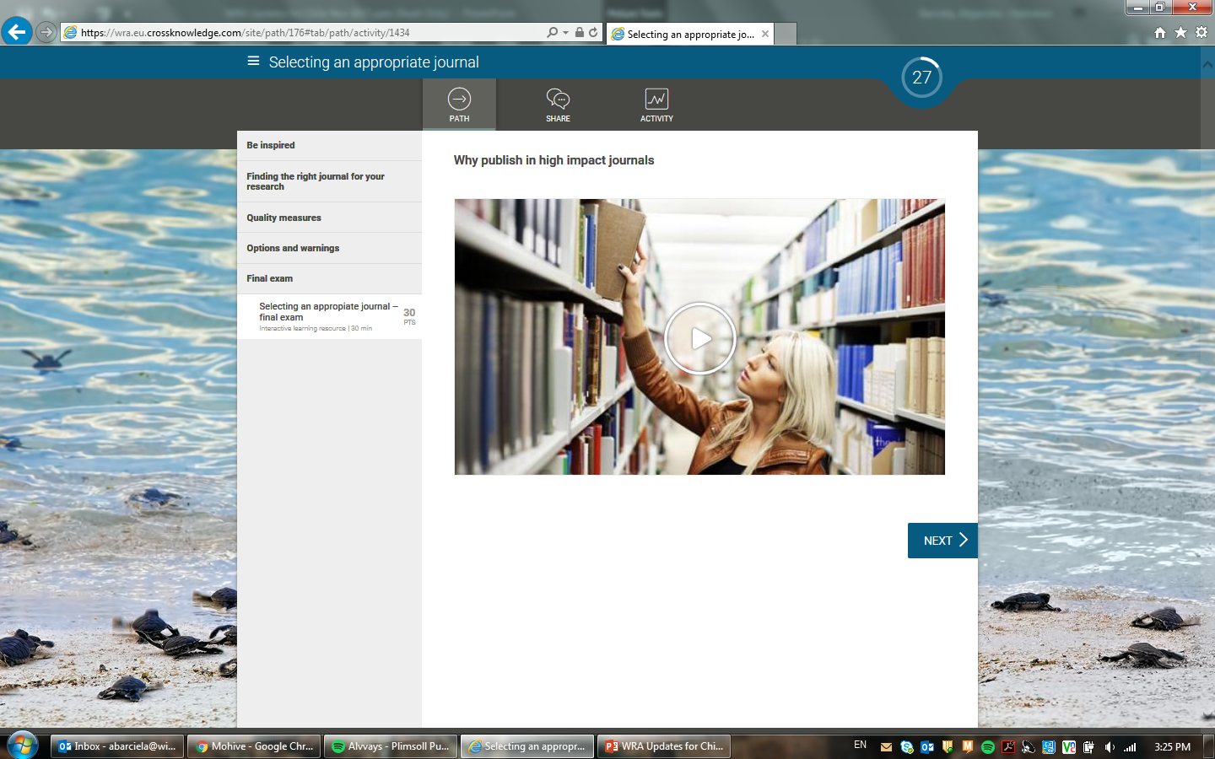
Final exam placed at the end of each Learning Path

Slide 6
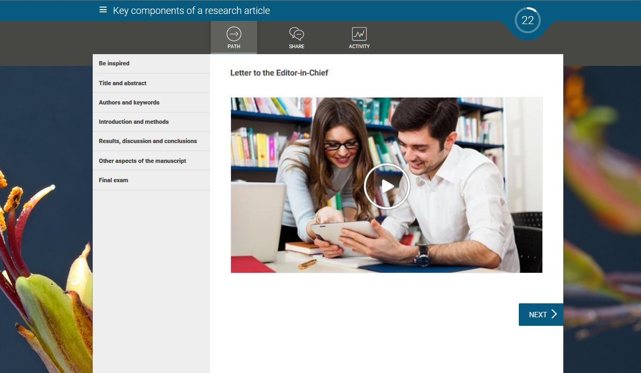
Modules grouped by themes so it’s easy to find what you want

Slide 7
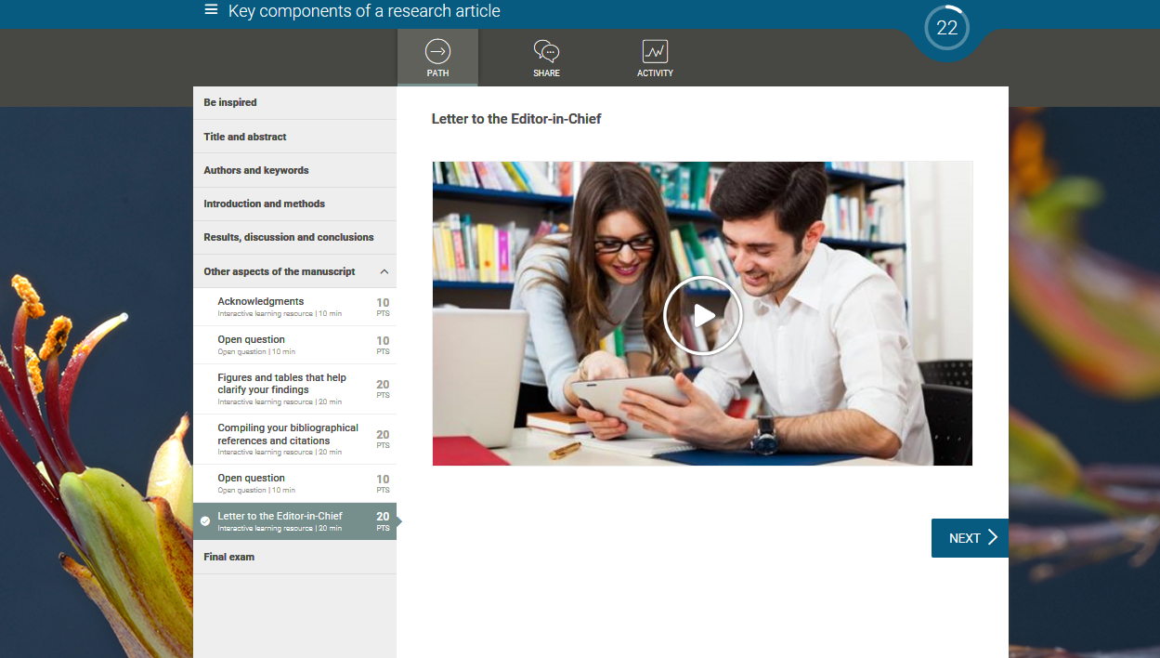
A drop-down menu reveals topics in detail
Notes:
Each step can contain a variety of learning objects (from polls to assignments and modules) to offer a true blended learning experience.

Slide 8
Optional pre-assessments to measure your knowledge

Slide 9
Gamification

Slide 10
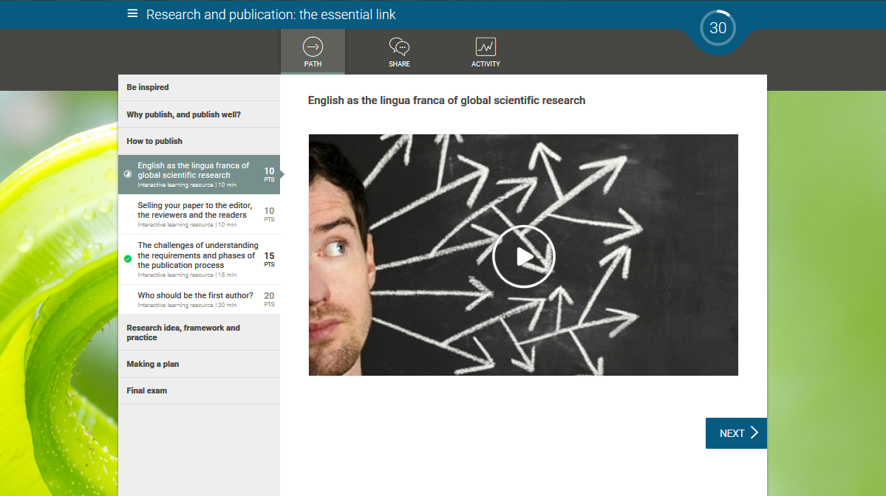
Increase motivation with gamification
Notes:
The learner must reach a specific point threshold in order to complete the course.
Stimulate competition among users and increase motivation.

Slide 11
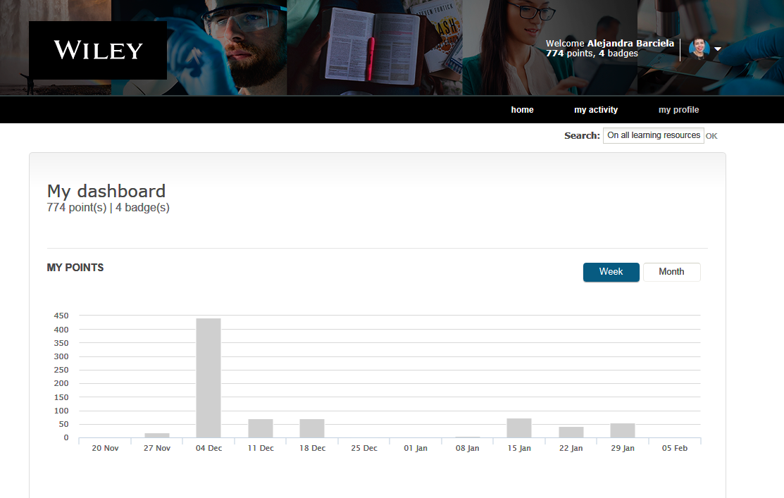
Gamification: individual user’s dashboard

Slide 12
Gamification: individual user’s dashboard

Slide 13
Social Features

Slide 14
Social features: open questions for groups
Notes:
Promote more social interactions by posing questions to registered learners.
Gather learners’ opinion of the course.
Create a community for researchers

Slide 15
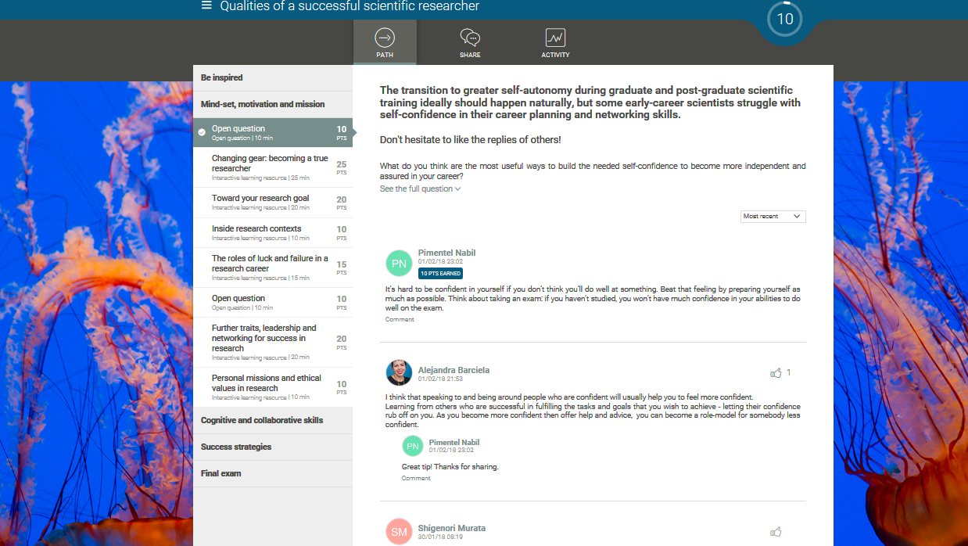
Comment, like, and engage in conversation with other researchers
Notes:
Allow learners to present themselves.
Learn together and share experiences.

Slide 16
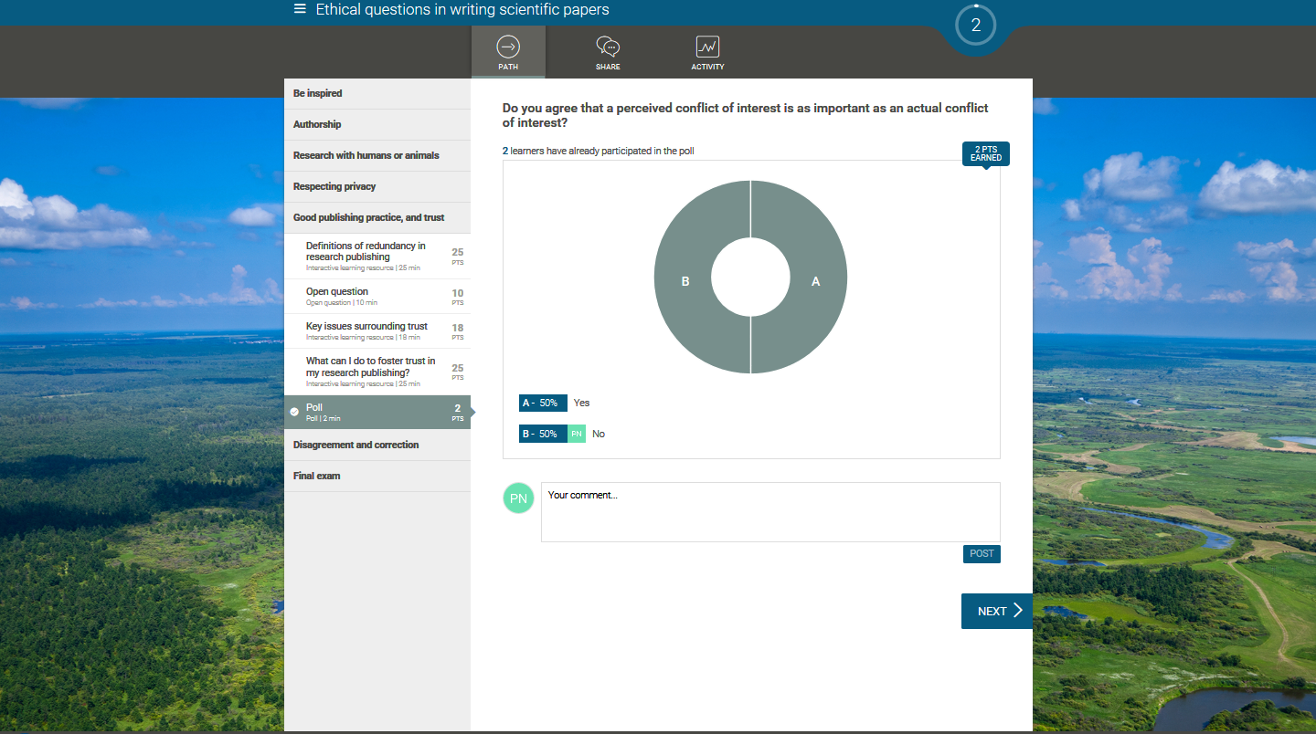
Poll questions with live results
Notes:
Learners make their opinions visible by voting with their peers.
Stimulate discussion in the comments.
The results are refreshed in real time.

Slide 17
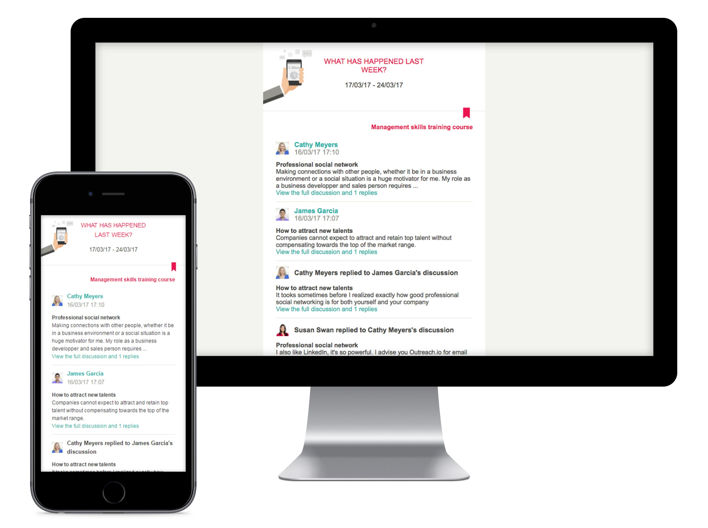
Social newsletter: weekly updates on the activity in the course
Notes:
Get weekly updates on the social activity in the course.
Create simple and effective communication plans.

Slide 18
Certificates

Slide 19
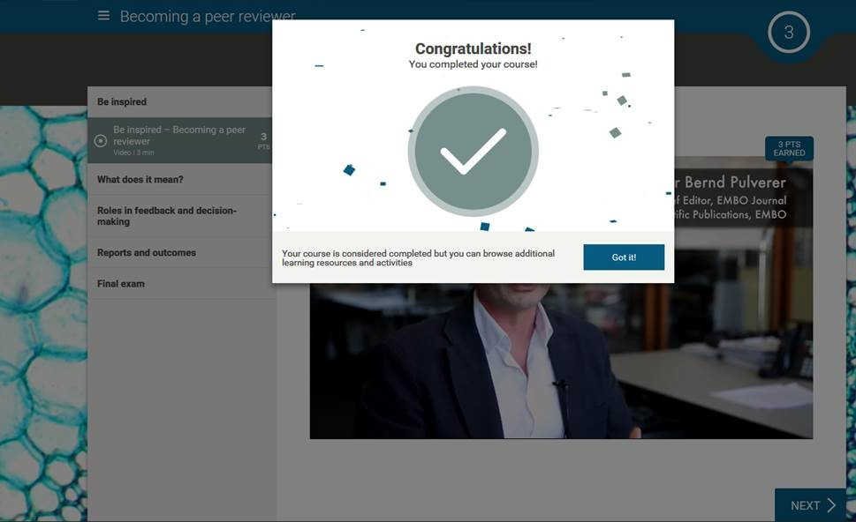
Certificates for each course completed within the WRA
Notes:
WRA now allows learners to receive certificates on an LP basis (not just the final one), automatically. They can also export these certificates to their LinkedIn profiles.

Slide 20
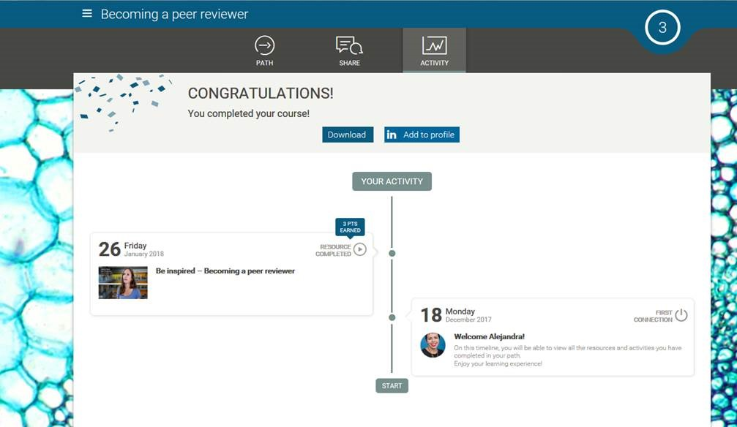
Certificates: available for download or export to LinkedIn
Notes:
WRA now allows learners to receive certificates on an LP basis (not just the final one), automatically. They can also export those certificates to their LinkedIn profiles.

Slide 21
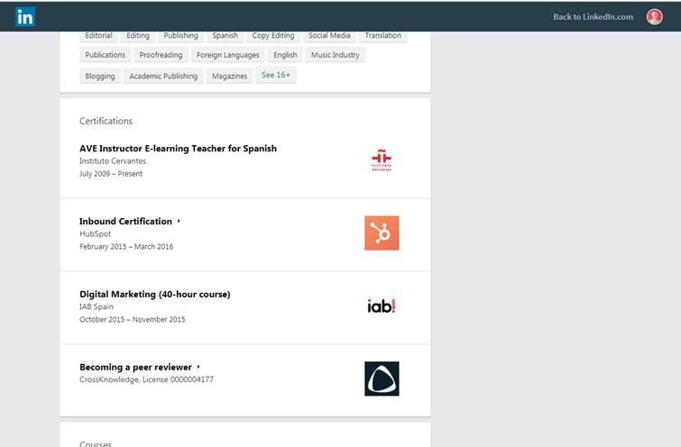
Certificates: visible in LinkedIn profiles
Notes:
WRA now allows learners to receive certificates on an LP basis (not just the final one), automatically. They can also export those certificates to their LinkedIn profiles.

Slide 22
Course Access

Slide 23
Revamped homepage
Simplified main menu
Search bar
Direct access to courses from the homepage

Slide 24
Course accessibility
Direct access to courses from the WRA homepage:
When hovering over a course, users see the course description and duration, without opening a new window
Fewer clicks to reach the content.

Slide 25
Facilitator Role

Slide 26
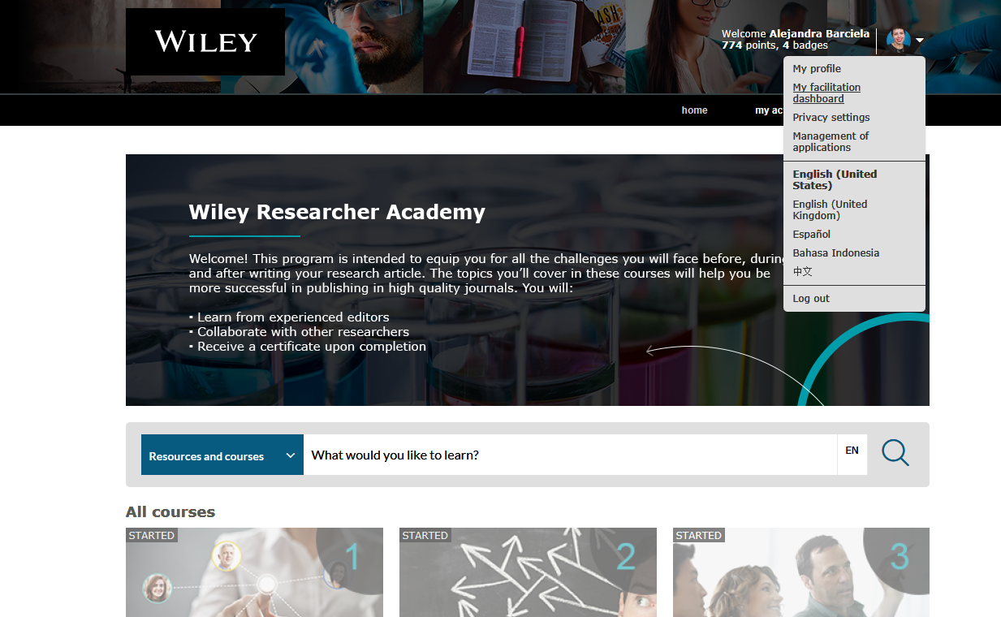
Facilitator dashboard: for clients, from learners’ interface
Notes:
Facilitator:
New role, intended to act as a coach/SME -similar to what we think of a “mentor”
Front office access: seamless experience as he/she accesses the same interface as the learner but with an additional tab for facilitators – no need to deal with back office
Little to no training required - Facilitator Guide is provided as PDF
Access to dashboard and analytics to monitor learner’s progress –visual data representation, perhaps more actionable
Can be assigned on a Learning Path basis, so we can assign different facilitators in different LPs depending on fields of expertise

Slide 27
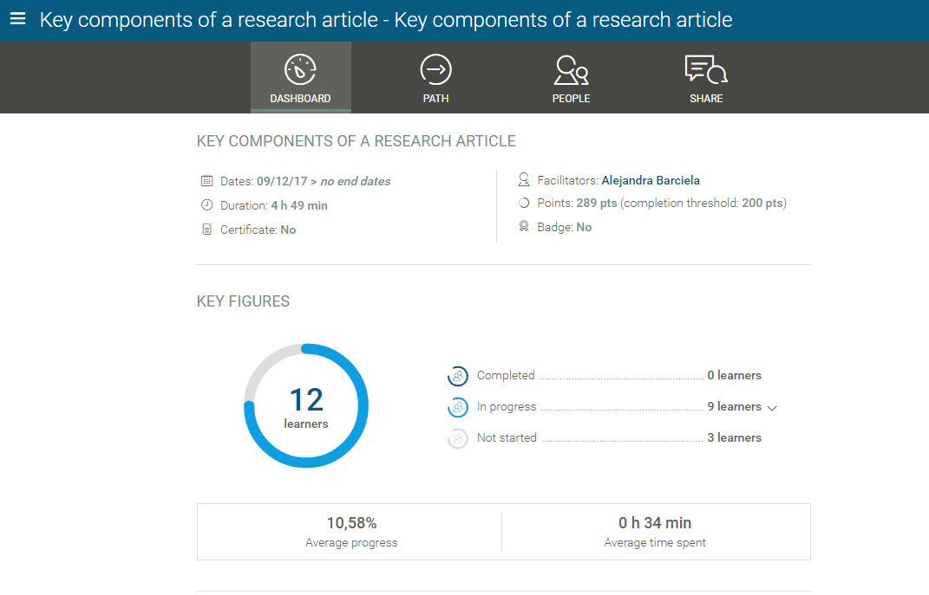
Facilitator dashboard: monitoring learners’ progress
Notes:
A facilitator from the institution can be assigned to one or more courses to closely monitor learners’ progress, moderate discussions, access reports.
Actionable data to promote engagement and drive the learning experience

Slide 28
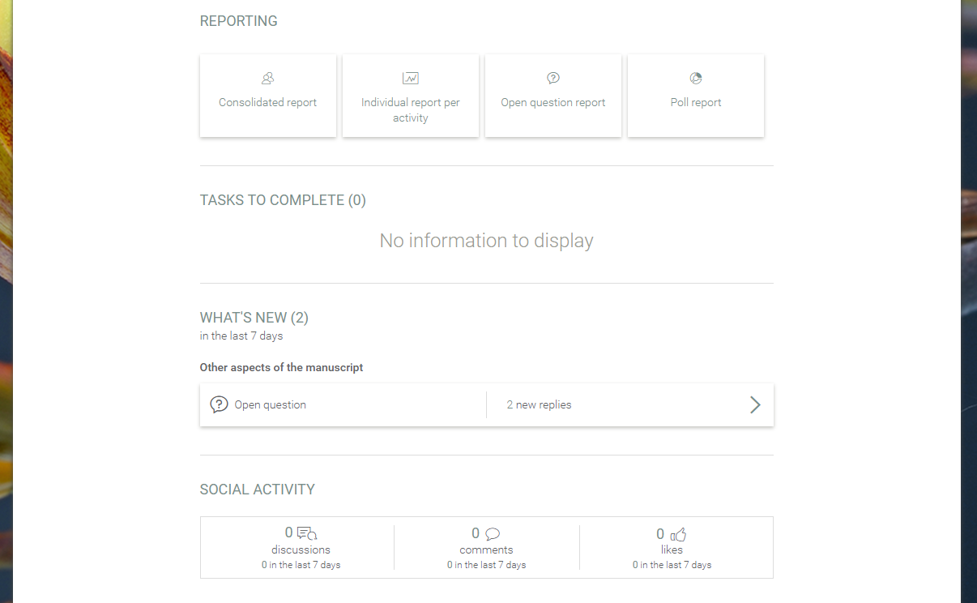
Facilitator dashboard: access to reports and discussions
Notes:
Access to reports from the learners’ interface
User friendly interface
Notification panel with new comments, poll results

Slide 29
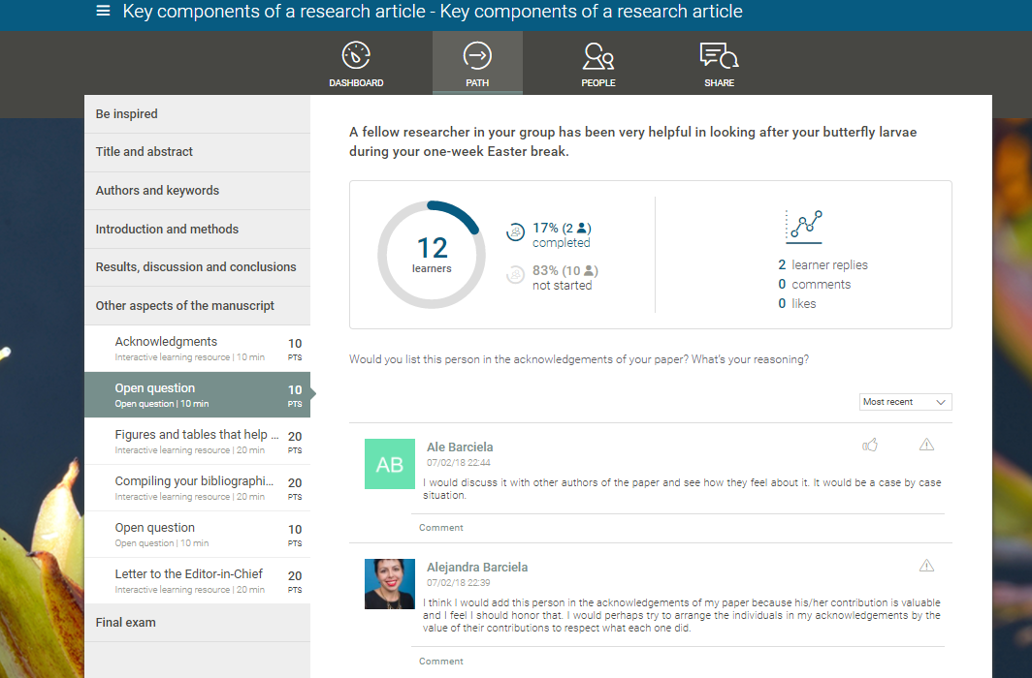
Facilitator dashboard: moderating discussions, poll results
Notes:
Poll results (live)
Ability to comment on learners’ comments

Slide 30
ADA Compliance

Slide 31
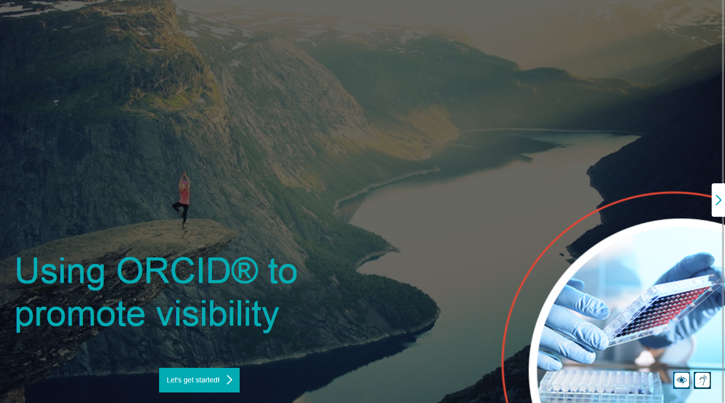
Audio transcripts can be enabled by the user

Slide 32
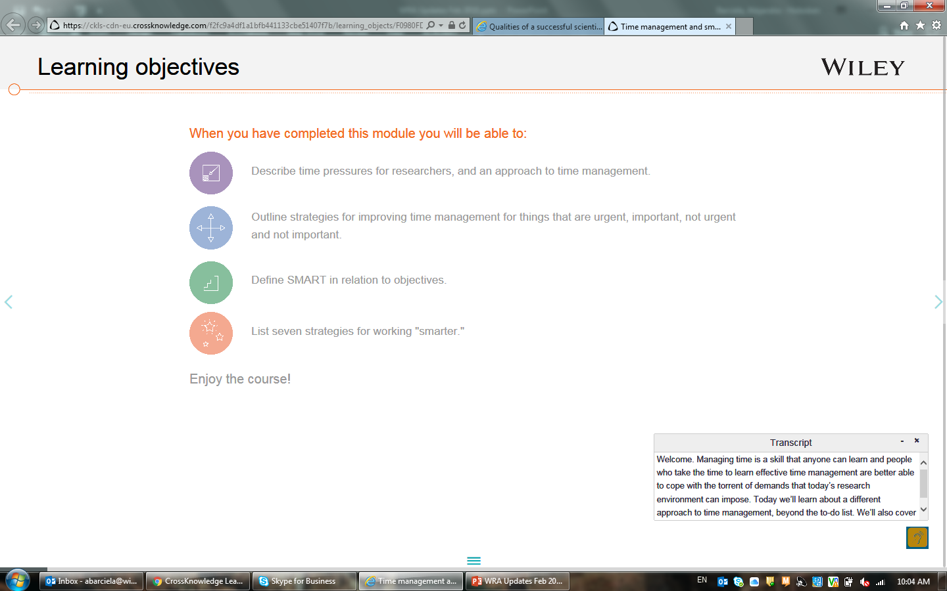
Audio transcripts

Slide 33
Video subtitles in all the videos

