Slide 1


BEN RAN Event, Moscow on April 4, 2018

Slide 2



Wiley Today – Our Business
In the lab
In the classroom
Online
Publish >1600 journals
15 million researchers
use Wiley journals
Textbooks
Course Material
Databases
Course Workflow
Test Preparation
>6 million use our
online training programs
Corporate Learning
Assessment

Slide 3

Wiley: drives progress and fuels innovation
Wiley has been a valued source of information for more than 210 years.
Wiley’s content, products, and services help researchers, professionals, educators, and students around the world meet their needs and fulfill their aspirations.
Wiley has 70 offices and facilities in 28 countries, with customers in over 200 countries.
500 Nobel Laureates
Published
$1.8 Billion
Total Revenue
58% of Revenue
Outside United States
5,000 Employees
Globally

Slide 4
Wiley: at a glance
15 million researchers and professionals use Wiley Journals
1,200 Society and nonprofit partners
222 online program partnerships with 39 universities
6 million using Wiley training platforms
500 Nobel Laureates have published in Wiley journals
1,204 journals indexed in Web of Science (73% of the Wiley portfolio)
58% of Wiley journals increased their Impact Factor between 2014 to 2015
26 Wiley journals achieved a top-category rank, including:
  CA-A Cancer Journal for Clinicians (IF 131.723, ranked #1 in Oncology)
  World Psychiatry (IF of 20.205, ranked #1 in Psychiatry)
Biological Reviews (IF of 10.725, ranked #1 in Biology)

Slide 5

Delivering author workshops around the globe.
Notes:
Wiley conducts authors workshops regularly around the world. Through conversations with authors and editors we constantly strive to learn their publishing challenges and devise ways to help these researchers succeed. One result is the Wiley Researcher Academy online training course on research publishing.

Slide 6

Pressures for Research-intensive Institutions
Rankings: increasingly, the reputation of academic institutions is based on research output (publications) and grant funding, rather than exclusively excellence at teaching.
Attracting investment: research funding is closely linked to research performance, with peer-reviewed publications recognized as the gold standard indicator used by funders.
Commercialization of research: for example through public-private partnerships or support for joint research centers.
Attracting and retaining talented staff, researchers and students: particularly against a global backdrop of extreme competition.
Supporting the development of students and staff: publishing in international journals is increasingly a compulsory requirement for students as well as faculty members.
Raising international profile: as developing countries are investing in their academic institutions, the number of potential partners (and competing institutions!) worldwide is growing.

Slide 7
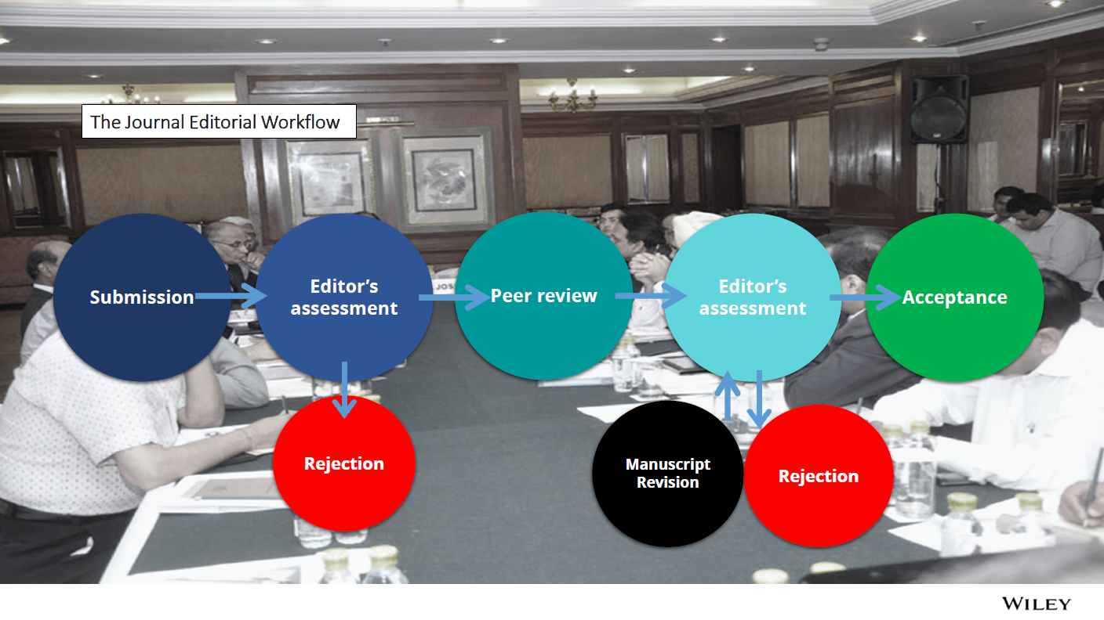
The Editorial Workflow

Slide 8
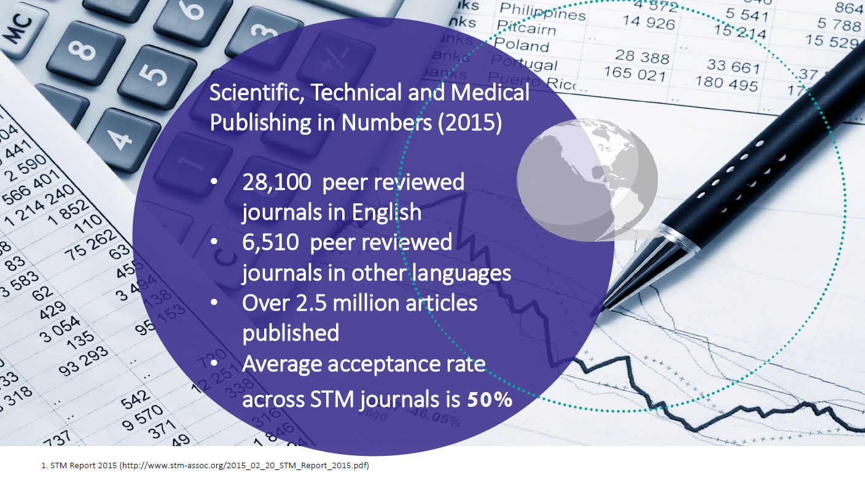

Slide 9
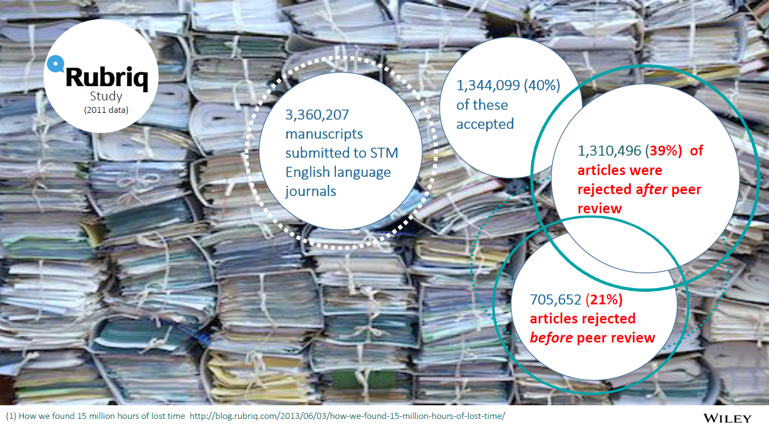

Slide 10
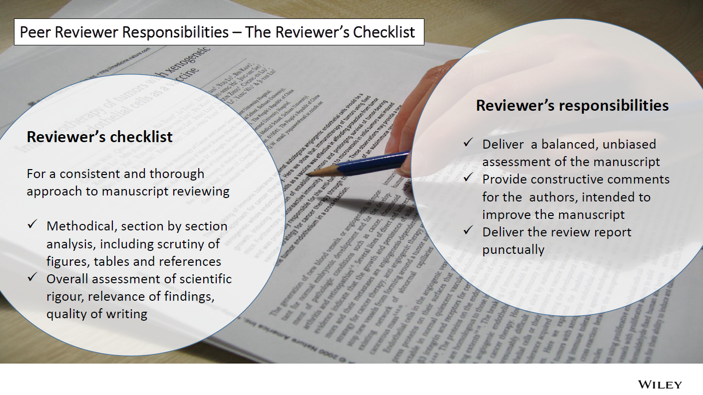

Slide 11
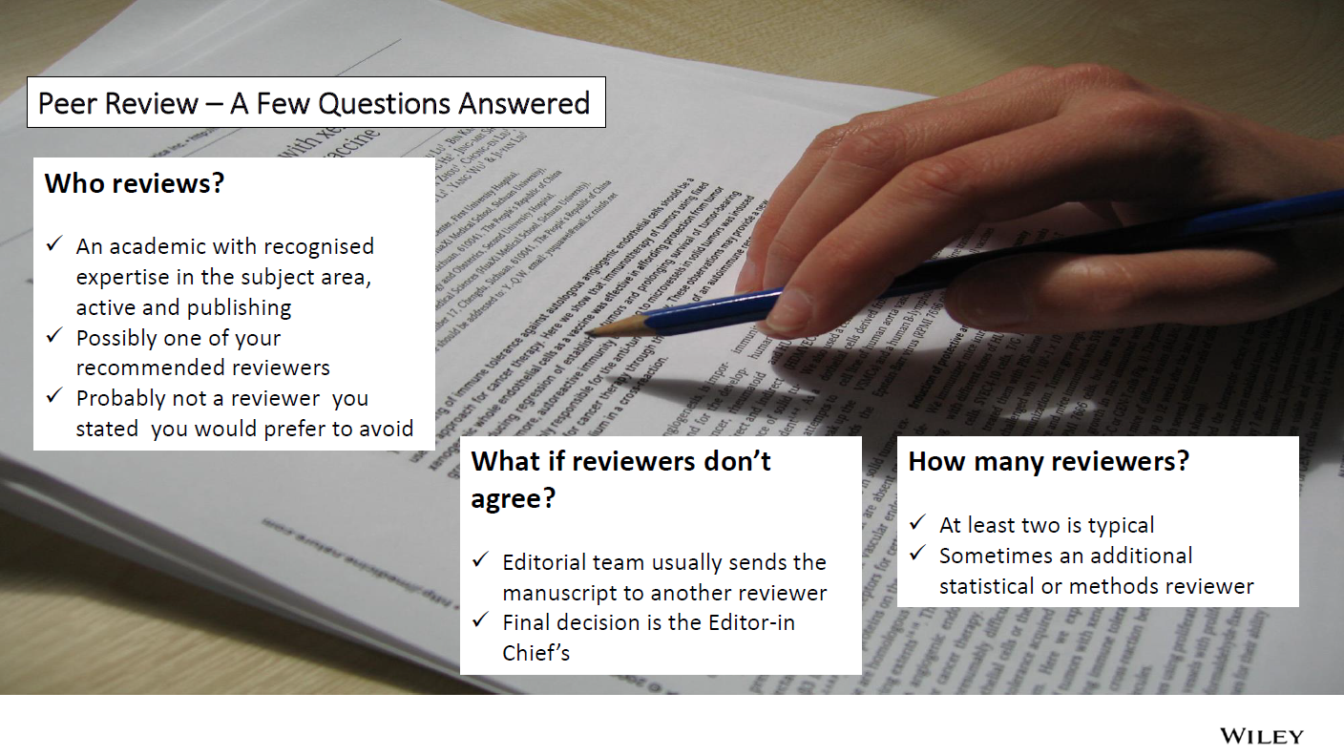

Slide 12
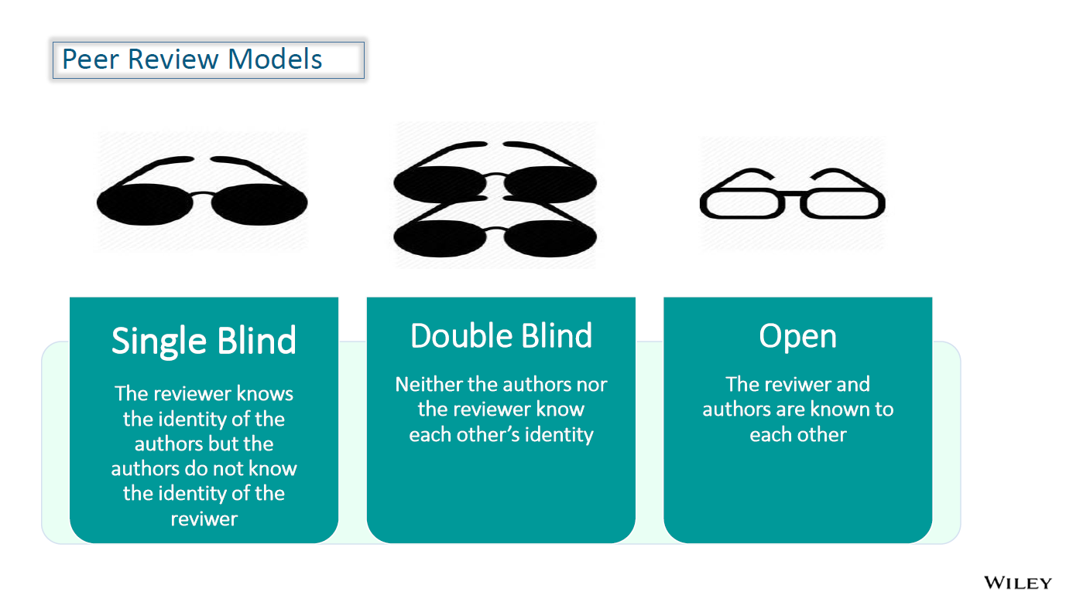

Slide 13
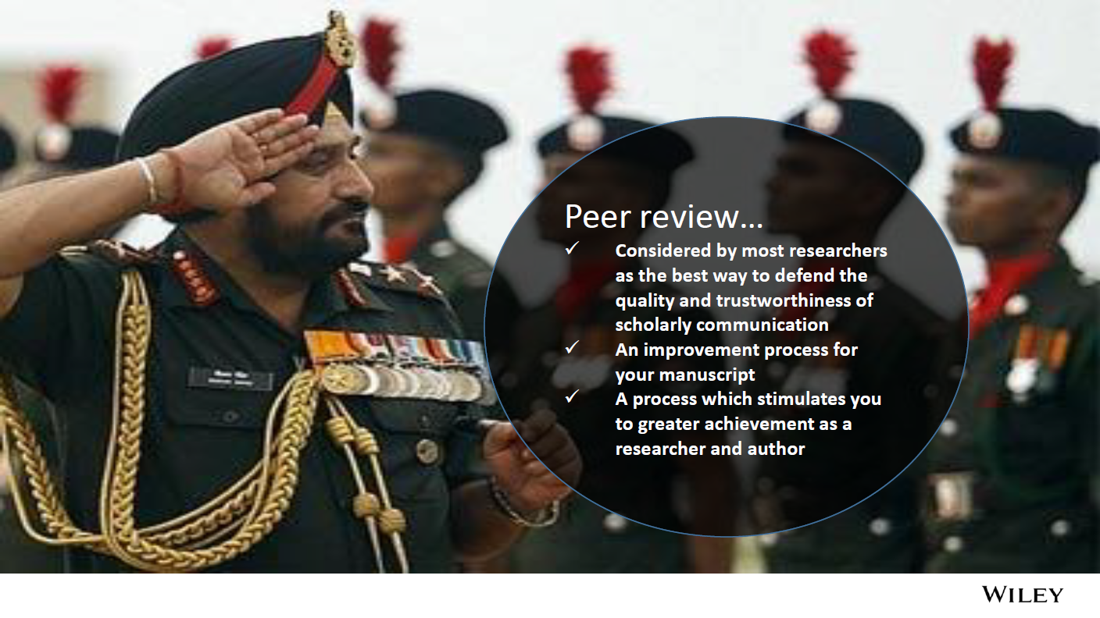

Slide 14
Why Are Articles Rejected?
Is simply a small extension of a different paper, often from the same authors
Not within the aims & scope of the journal
Procedures and/or analysis of the data is seen to be defective
The conclusions cannot be justified on the basis of the rest of the paper
The manuscript is not complete/lacking key elements such as the title, authors, affiliations, keywords, main text, references and all tables and figures
The English is not sufficient for the peer review process
The figures are not complete or are not clear enough to read
The article does not conform to the guide for authors
References are incomplete or very old
Currently under review at another journal
The article contains elements that are suspected to be plagiarized
It’s incomprehensible (e.g., the language, structure or figures are poor)
It’s boring
Peter Thrower, PhD, is Editor-in-Chief of Carbon, The International Journal of the American Carbon Society, and Professor Emeritus of Material Sciences and Engineering at Penn State University
Notes:
9 (in red) of these 13 reasons are publishing problems, not science problems. All the red items could be avoided or solved by having sufficient knowledge of the writing and publishing processes.

Slide 15
Why Are Articles Rejected?
Most of these problems relate to publishing, not the underlying science..
Is simply a small extension of a different paper, often from the same authors
Not within the aims & scope of the journal
Procedures and/or analysis of the data is seen to be defective
The conclusions cannot be justified on the basis of the rest of the paper
The manuscript is not complete/lacking key elements such as the title, authors, affiliations, keywords, main text, references and all tables and figures
The English is not sufficient for the peer review process
The figures are not complete or are not clear enough to read
The article does not conform to the guide for authors
References are incomplete or very old
Currently under review at another journal
The article contains elements that are suspected to be plagiarized
It’s incomprehensible (e.g., the language, structure or figures are poor)
It’s boring
Peter Thrower, PhD, is Editor-in-Chief of Carbon, The International Journal of the American Carbon Society, and Professor Emeritus of Material Sciences and Engineering at Penn State University
Notes:
9 (in red) of these 13 reasons are publishing problems, not science problems. All the red items could be avoided or solved by having sufficient knowledge of the writing and publishing processes.

Slide 16


Slide 17
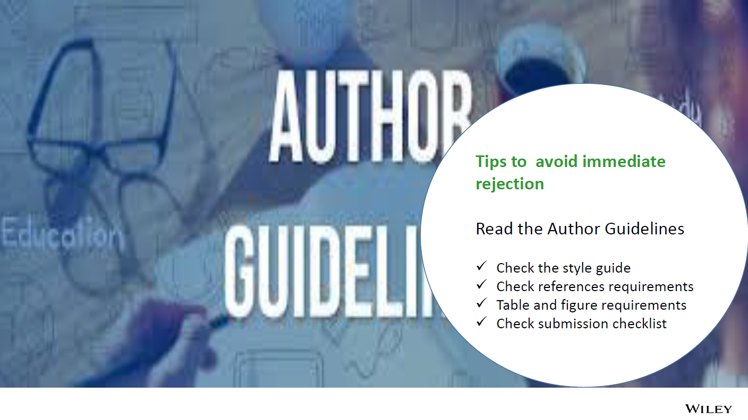

Slide 18
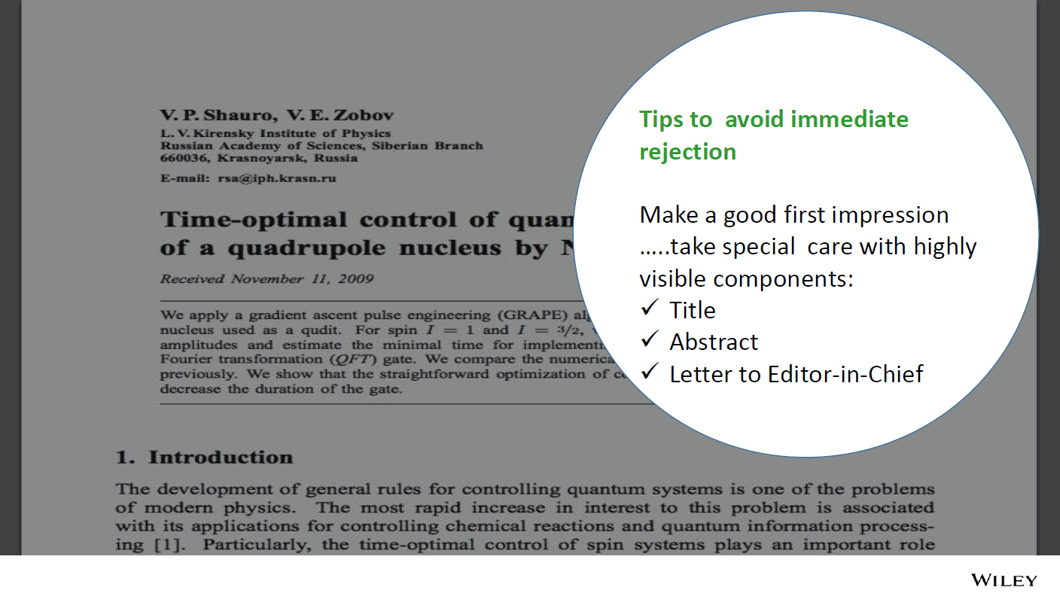

Slide 19
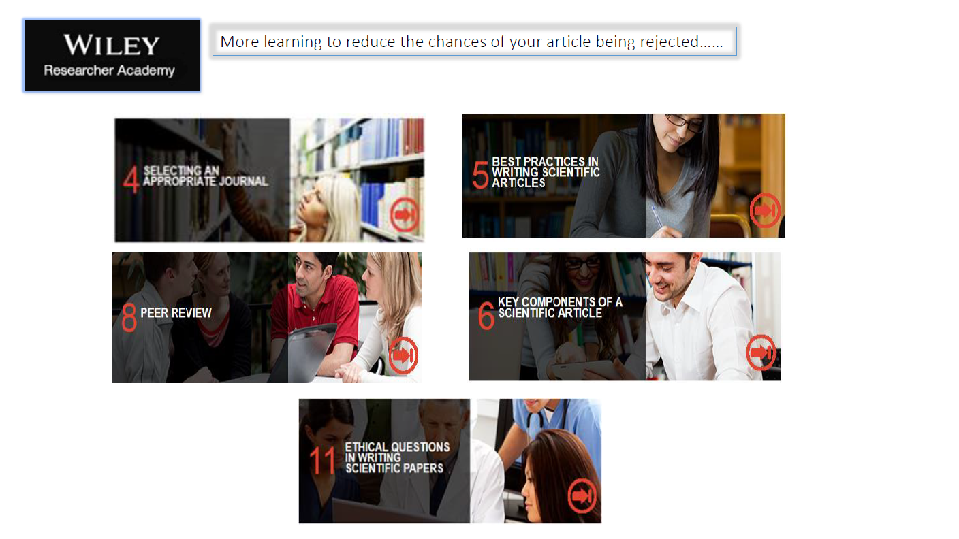

Slide 20
BRICS Acceptance Rates
Acceptance Rates - BRICS
Sum of acceptance | Column Labels
Row Labels | Brazil | China | India | Russian Federation | South Africa | Grand Total
2013 | 19,8% | 18,7% | 12,7% | 33,6% | 28,7% | 17,9%
2014 | 19,7% | 18,4% | 12,8% | 28,6% | 28,3% | 17,6%
2015 | 19,8% | 18,6% | 13,1% | 28,4% | 26,2% | 17,9%
2016 | 19,0% | 18,0% | 14,0% | 23,5% | 28,0% | 17,6%
2017 | 20,0% | 19,0% | 14,8% | 25,5% | 26,4% | 18,6%
2018 | 22,5% | 19,1% | 14,2% | 27,5% | 29,2% | 18,8%
Grand Total | 19,7% | 18,6% | 13,5% | 27,4% | 27,5% | 18,0%

Slide 21
BRICS Research Output Graphs
Country | 2010 | 2011 | 2012 | 2013 | 2014 | 2015 | 2016 | 2017 | 2018 | Growth Rate (CAGR)
Brazil | 37.590 | 41.225 | 44.223 | 46.824 | 49.002 | 52.080 | 55.829 | 54.620 | 2.704 | 5,5%
China | 143.685 | 167.603 | 194.106 | 228.213 | 263.043 | 294.799 | 318.795 | 349.655 | 22.856 | 13,5%
India | 48.209 | 54.171 | 58.969 | 66.242 | 74.446 | 79.924 | 84.406 | 83.518 | 4.513 | 8,2%
Russian Federation | 30.408 | 32.818 | 32.298 | 34.486 | 36.485 | 42.029 | 46.833 | 45.149 | 1.379 | 5,8%
South Africa | 9.607 | 11.014 | 12.033 | 12.959 | 14.301 | 15.608 | 17.001 | 16.536 | 810 | 8,1%
World Totals | 1.349.517 | 1.443.670 | 1.530.384 | 1.618.853 | 1.675.680 | 1.748.551 | 1.823.793 | 1.789.918 | 94.447 | 4,1%
 |  |  |  |  |  |  |  |  | Country | Growth Rate (CAGR)
 |  |  |  |  |  |  |  |  | Brazil | 5,5%
 |  |  |  |  |  |  |  |  | China | 13,5%
 |  |  |  |  |  |  |  |  | India | 8,2%
 |  |  |  |  |  |  |  |  | Russian Federation | 5,8%
 |  |  |  |  |  |  |  |  | South Africa | 8,1%
 |  |  |  |  |  |  |  |  | World Totals | 4,1%
Compares trend of research output (articles and reviews only) by country. Based on Web of Science data from EBAC.

Slide 22
BRICS – OA Trends
Country | 2010 | 2011 | 2012 | 2013 | 2014 | 2015 | 2016 | 2017 | 2018 | Change in Share
Brazil | 38% | 38% | 36% | 35% | 35% | 33% | 30% | 30% | 14% | -8%
China | 9% | 11% | 13% | 15% | 17% | 18% | 19% | 19% | 8% | 10%
India | 18% | 19% | 19% | 21% | 22% | 20% | 19% | 18% | 6% | 0%
Russian Federation | 6% | 7% | 8% | 8% | 9% | 9% | 9% | 10% | 6% | 4%
South Africa | 19% | 23% | 22% | 23% | 22% | 22% | 23% | 25% | 11% | 5%
 |  |  |  |  |  |  |  |  |  | #WERT!
Shows only papers published in full OA journals. Hybrid OA is not included.

Slide 23
BRICS –Relative Citation Impact Graphs
Country | 2010 | 2011 | 2012 | 2013 | 2014 | 2015 | 2016 | 2017 | 2018
Brazil | 0,65 | 0,65 | 0,67 | 0,69 | 0,70 | 0,75 | 0,81 | 0,76 | 0,56
China | 0,98 | 1,03 | 1,10 | 1,12 | 1,16 | 1,20 | 1,22 | 1,15 | 0,86
India | 0,71 | 0,72 | 0,74 | 0,74 | 0,77 | 0,78 | 0,85 | 0,82 | 0,96
Russian Federation | 0,46 | 0,47 | 0,58 | 0,56 | 0,65 | 0,63 | 0,67 | 0,67 | 1,10
South Africa | 0,93 | 0,89 | 0,97 | 0,96 | 1,05 | 1,02 | 1,09 | 1,11 | 1,75
Relative Citation Impact = average cites per article in each year, weighted by the world average. A Relative Citation Impact of 1 means that your citation impact is equal to the world average.

Slide 24
Challenges for researchers
Career success for researchers is highly dependent on a strong research program and publication record.
Grant funding is highly dependent on a strong research and publication program.
Early-career (grad/med students, postdocs, junior faculty) and international researchers typically struggle with getting published.
The Bottom Line
Training is critical to produce the most high-quality manuscripts and achieve the fastest route to high-visibility publication.

Slide 25




The Wiley Researcher Academy
A self-paced, pedagogically designed online course that delivers high-quality training on research writing and publishing.

Slide 26
Comprehensive, self-paced, online learning programme to support continued growth in the quantity and quality of scientific articles published by the national research community.

Slide 27


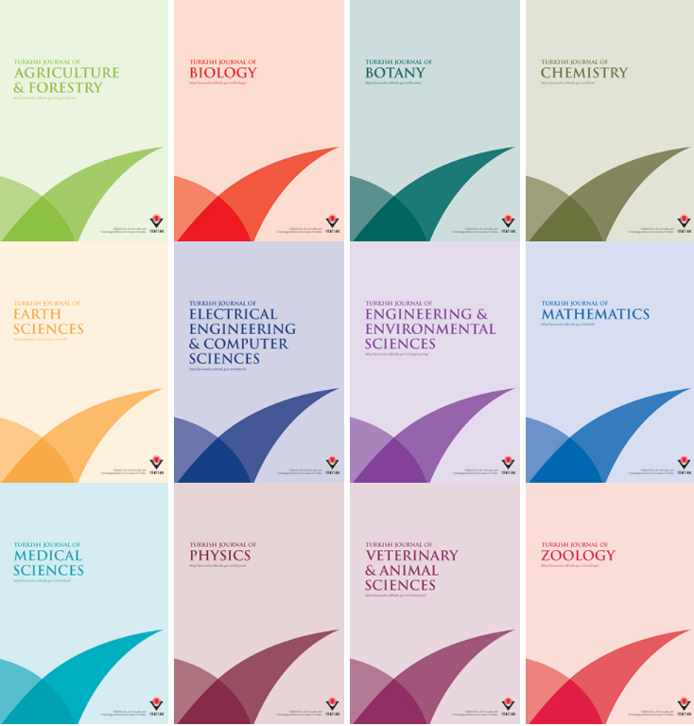


Notes:
Work with governments to shape the programme for success with national targets for research and demonstrate RO1

Slide 28

The goal of the Wiley Researcher Academy is to help researchers write higher quality manuscripts and allow faster publication, thus more rapidly advancing their careers and increasing the research output of their institutions.

Slide 29

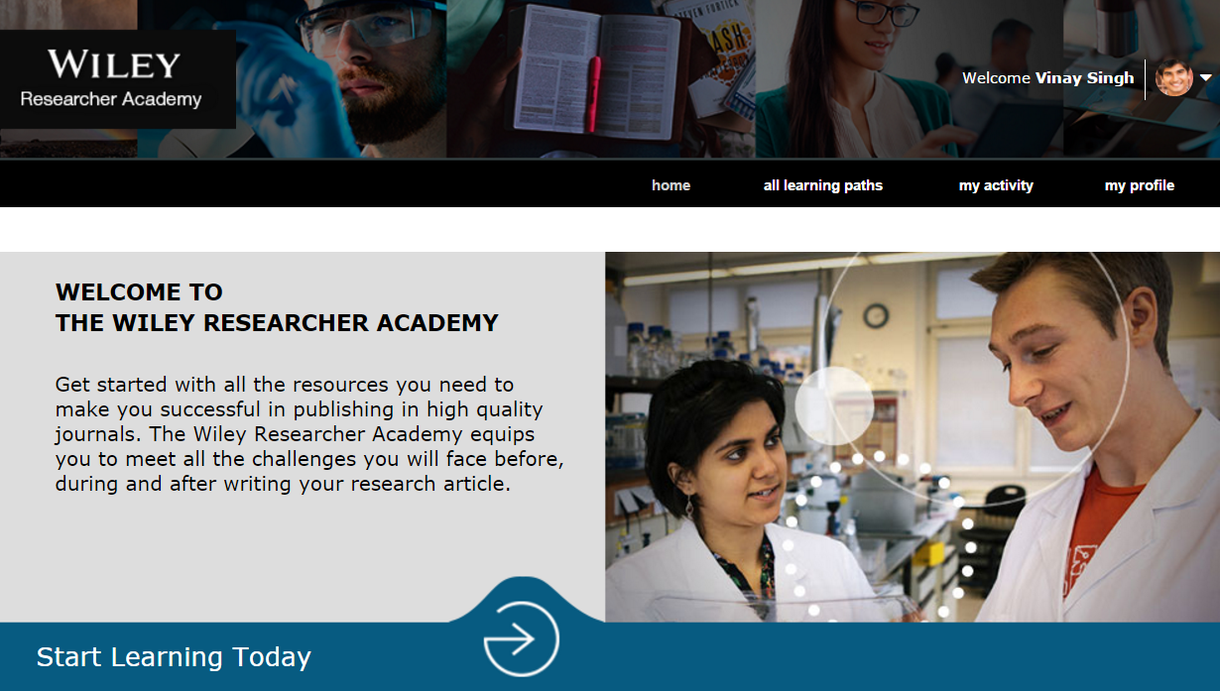

Qualities of a successful scientific researcher
Research and publication: the essential link
Financing the research project
Selecting an appropriate journal
Best practices in writing scientific articles
Key components of a scientific article
Manuscript submission
Peer review
Open access to scientific literature
Managing research data
Ethical questions in writing scientific papers
The roles of the publisher and journal editors
Post-publication activities and driving visibility
Becoming a peer reviewer
14 Learning Paths, over 50 hours of online learning

Slide 30
Qualities of a successful scientific researcher
Research and publication: the essential link
Financing the research project
Selecting an appropriate journal
Best practices in writing scientific articles
Key components of a scientific article
Manuscript submission
Peer review
Open access to scientific literature
Managing research data
Ethical questions in writing scientific papers
The roles of the publisher and journal editors
Post-publication activities and driving visibility
Becoming a peer reviewer
Curriculum customised to cover the national dimension of key topics
Suitable for scientists of all disciplines
National customer’s own modules can be incoporated

Slide 31
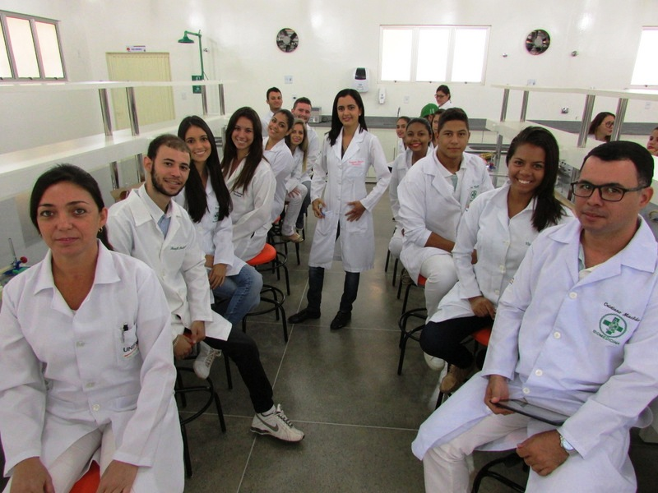

Essential learning for PhD students and Early-Career Researchers, excellent skills renewal for Mid- Career Researchers

Slide 32
Modular, self-paced, online
learning program for early career researchers who wish to develop their expertise and understanding of the publishing process;
and mid-career researchers seeking to update and perfect their skills.

Slide 33





14
Learning Paths with Final Exams
210
Modules
50
Hours of Learning
200
Video Clips
28
Assessments

Slide 34

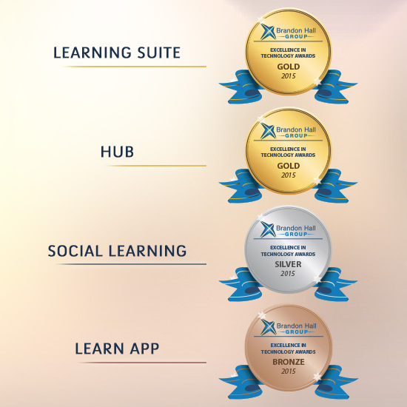


CrossKnowledge has supported 8 million distance learners since 2000
Industry-leading usage rates (90%) and completion rates (80%)

Slide 35

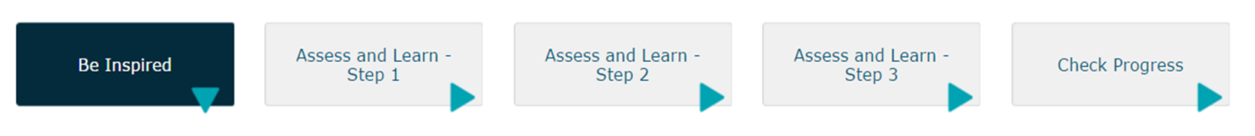
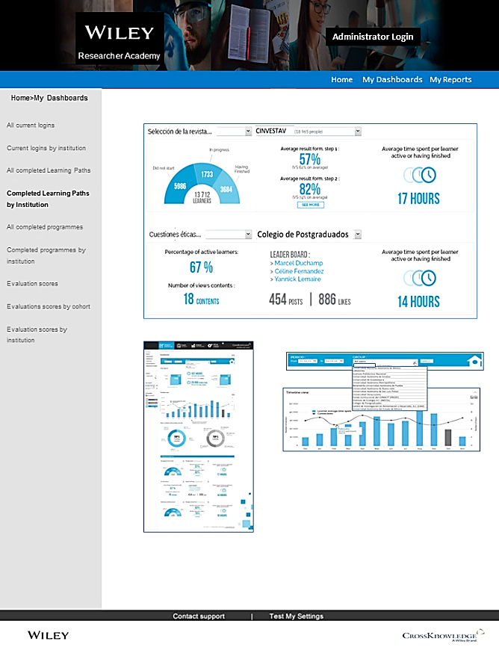
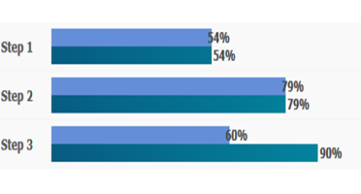


The first of its kind, a scalable solution, for training scientific authors, valid in pedagogical terms and capable of delivering measurable results.
Take Final Exam

Slide 36

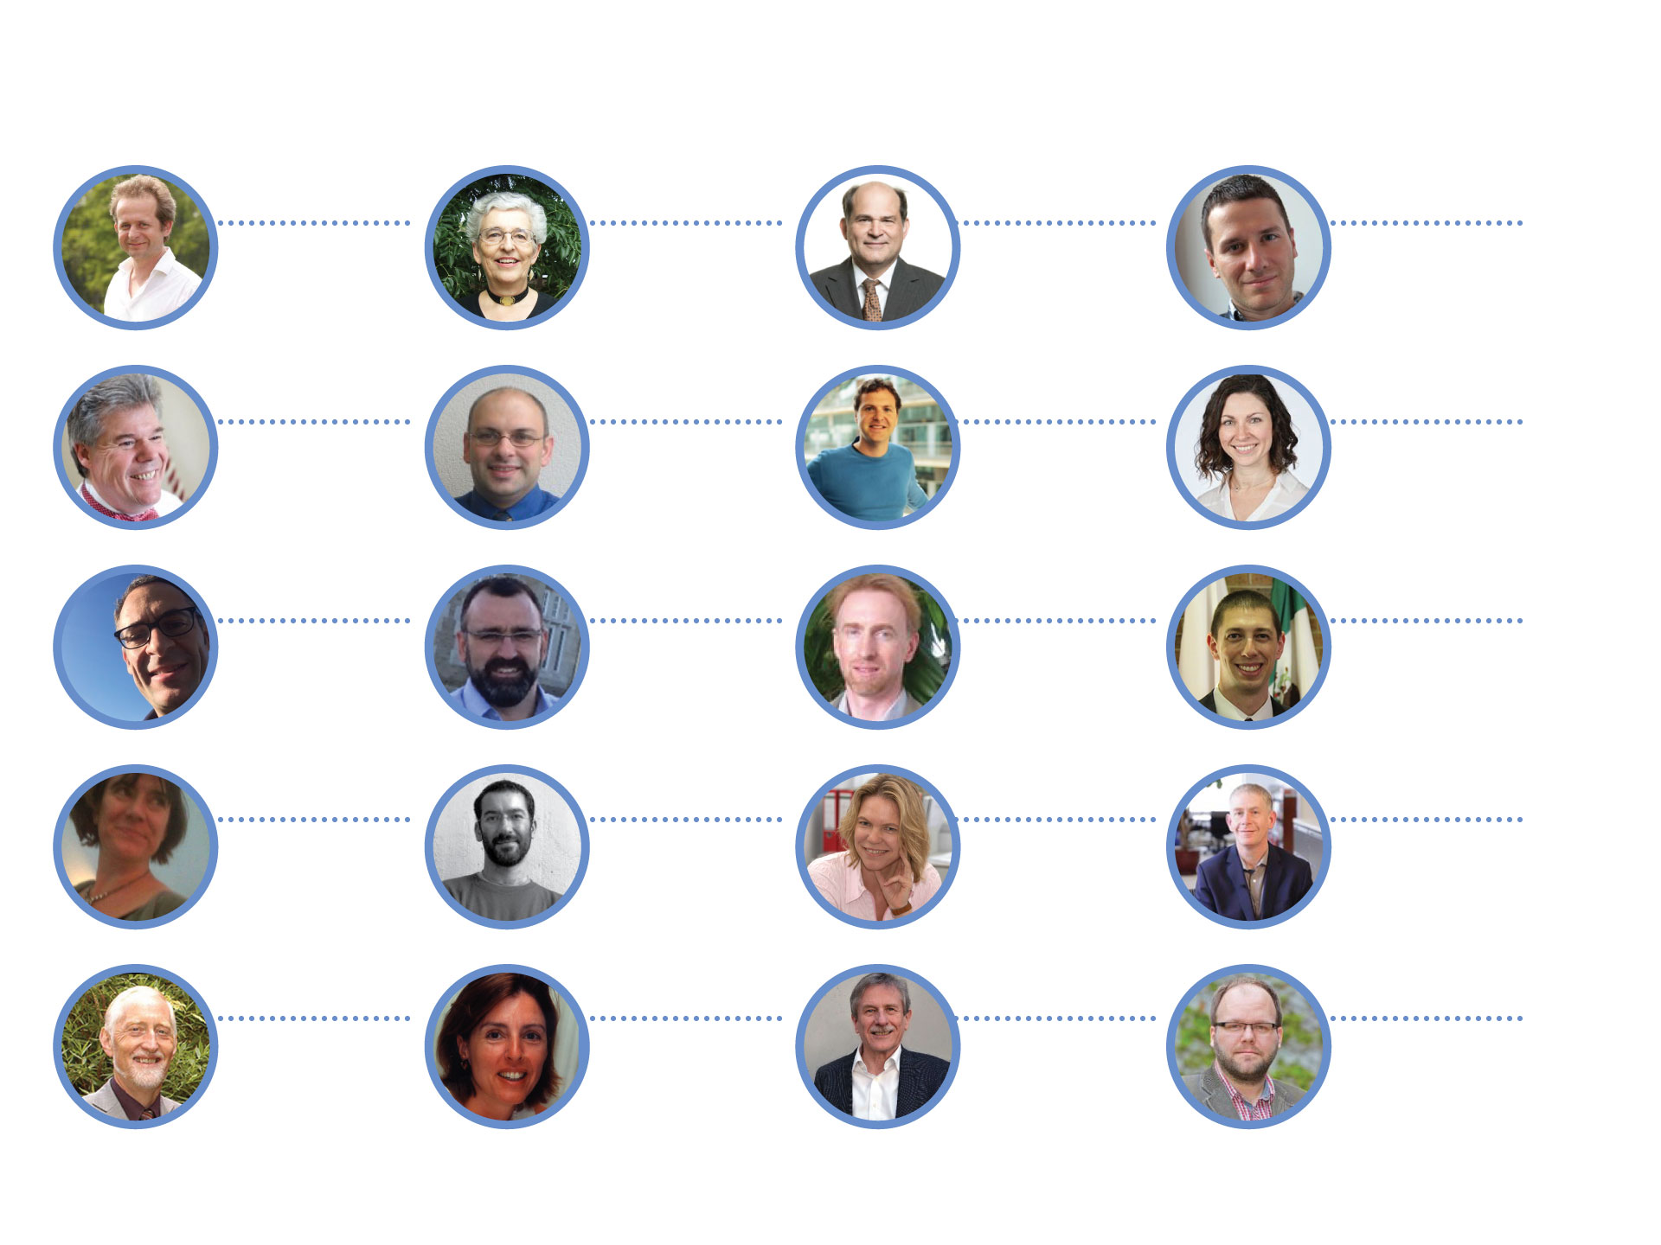

Distinguished panel of contributors
Developed, written and presented by a global network of journal editors and industry experts including:
Dr. Bernd Pulverer
Head of Scientific Publications, EMBO
& Chief Editor,
EMBO Journal
Dr. Margaret Cargill
Adjunct Senior
Lecturer,
University of
Adelaide
Dr. Oliver Renn
Head of Science Communication,
ETH Zürich
Dr. Paul-André Genest
Adjunct Professor, Stanford University
& Senior Editor, Wiley
Prof. John Watts
Professor of
Materials Science,
University of Surrey
Dr. Jose Oliveira
EiC, Small and
Advanced Healthcare Materials
Dr. Mark Isalan
Reader in Gene
Network Engineering,
Imperial College
London
Dr. Jenny Mahoney
EiC, Journal of Polymer Science: Polymer Physics
Chris Graf
Co-Vice-Chair,
Committee on
Publication Ethics
Dr. David del Alamo
Manager,
EMBO Fellowships
Programme
Dr. Andrew Moore
EiC, Bioessays
EiC, Wiley Researcher Academy
Dr. Eric Prager
EiC, Journal of Neuroscience Research
Fiona Murphy
Publishing, Research
Data and Scholarly Communications
specialist
Dr. Matteo Cavalleri
EiC, International
Journal of Quantum Chemistry
Dr. Gerlind Wallon
Deputy Director,
EMBO
Dr. Gwen Taylor
Sr. Editor and Wiley Business Development Mgr.
Dr. Peter Hambleton
Trustee, Society of Chemical Industry & Executive Editor,
JCTB
Prof. Dr. Michaela Wänke
Psychology &
Social Psychology,
University of
Mannheim
Prof. Bernhard Plattner
Professor of
Computer Engineering,
ETH Zürich
Dr. Samuel Caddick
EMBO Lab Management Training

Slide 37
Scientific researchers fundamental competencies
- training is key
Specific Conceptual Knowledge of Discipline | Development of Research Skills | Communication Skills | Professionalism | Leadership and Management Skills | Responsible Research Conduct
Analytical approach to define questions Design of verifiable hypotheses Acquisition of interdisciplinary knowledge Detailed knowledge of the research area | Techniques of investigation and security Experimental design Analysis and interpretation of data Strategies of investigation and evaluation of literature Requests of financing and processes | Writing Oral presentation Teaching and tutoring Interpersonal communication skills Special situations | Workplace etiquette, standards and objectives Evaluation and improvement of third-party performance Participation in public and professional activities to advance the discipline Management of ethical and professional failures | Human resources management Project management Leadership | Ownership and sharing of data Research in human beings Research in animals Identification of professional faults Resolution of conflicts of interest
From: National Postdoctoral Association, http://www.nationalpostdoc.org/?SixCoreComps#i
Notes:
Formal training about research publishing using pedagogically designed material from experts will allow faster writing of manuscripts, submission to appropriate journals and overall faster publication.

Slide 38
Scientific researchers fundamental competencies
- training is key
Specific Conceptual Knowledge of Discipline | Development of Research Skills | Communication Skills | Professionalism | Leadership and Management Skills | Responsible Research Conduct
Analytical approach to define questions Design of verifiable hypotheses Acquisition of interdisciplinary knowledge Detailed knowledge of the research area | Techniques of investigation and security Experimental design Analysis and interpretation of data Strategies of investigation and evaluation of literature Requests of financing and processes | Writing Oral presentation Teaching and tutoring Interpersonal communication skills Special situations | Workplace etiquette, standards and objectives Evaluation and improvement of third-party performance Participation in public and professional activities to advance the discipline Management of ethical and professional failures | Human resources management Project management Leadership | Ownership and sharing of data Research in human beings Research in animals Identification of professional faults Resolution of conflicts of interest
From: National Postdoctoral Association, http://www.nationalpostdoc.org/?SixCoreComps#i
Notes:
The WRA addresses several of these key competencies: Communication Skills (writing), Professionalism (3rd and 4th bullet points), Responsible Research Conduct (data management/sharing, conflict resolution).

Slide 39

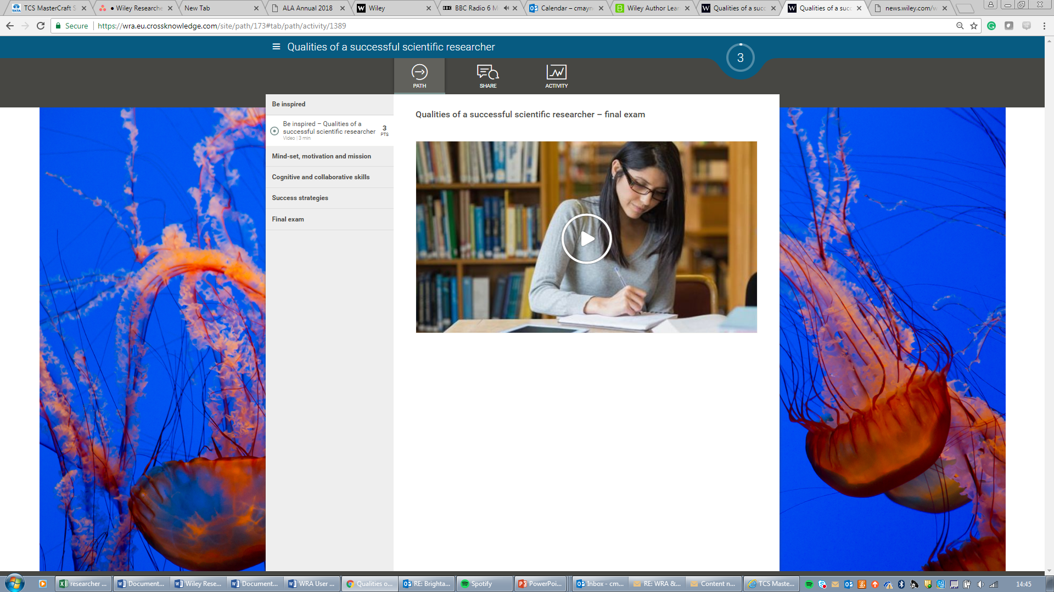

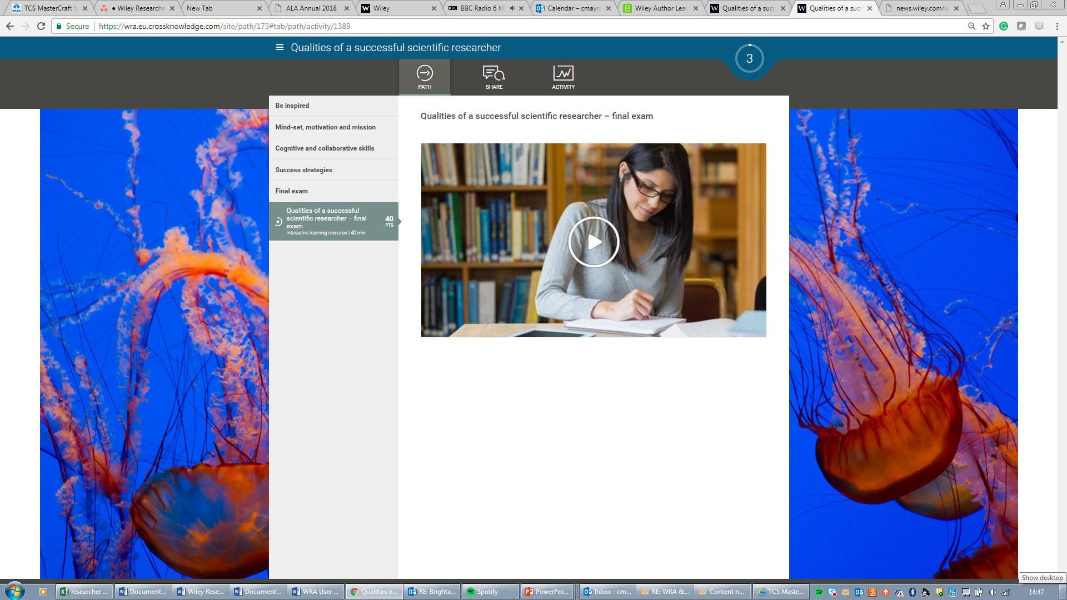
Robust instructional design
Competency-based learning delivering measurable results
Exams to test knowledge for each module
Reports on engagement, progress and completion available
Notes:
Pedagogically designed course to deliver measurable learning through pre- and post-learning testing. Each of the 14 Learning Paths has a Final Exam where the student can demonstrate comprehension.

Slide 40

Downloadable Dashboards and Reports

Slide 41
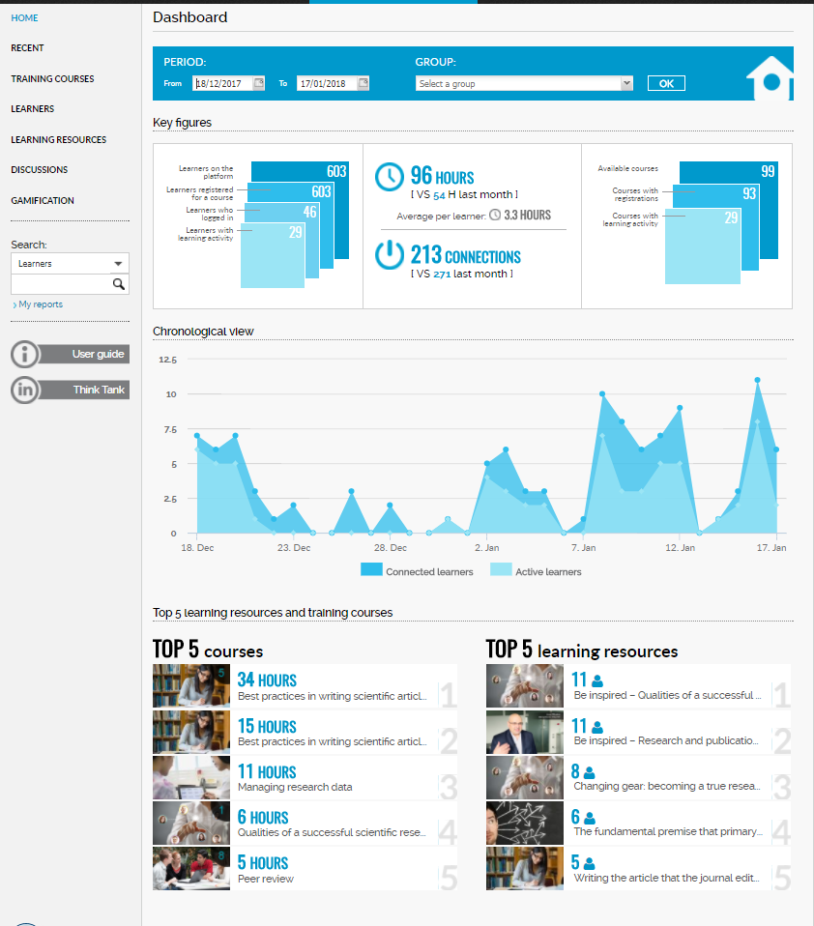
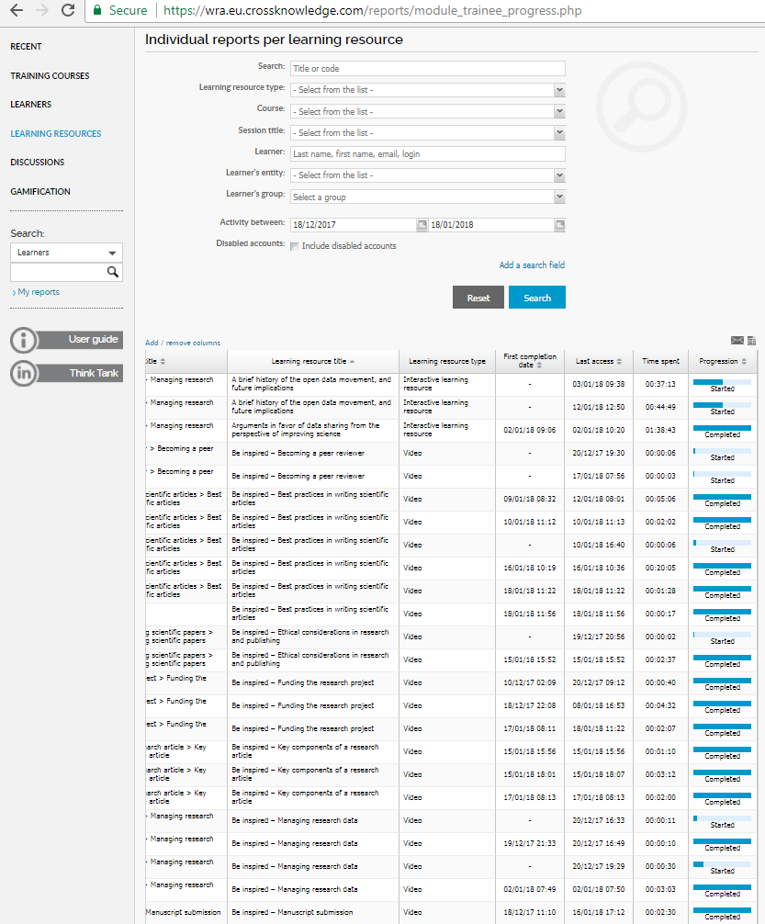
Exceptional reporting capability
Detailed Dashboard
Engagement communications
Downloadable reporting and analysis
Notes:
Completion of the course (or segments) equips the user with the knowledge and confidence to prepare higher quality manuscripts, to submit them to appropriate journals, and to navigate the peer review process efficiently, resulting in better and faster publication.

Slide 42
Sample report
Period: <date range>
Number of users accessing:
  Users who logged in: 276
  Users with learning activity: 165
Average time spent per learner on the platform: 6.6 hours
  Total: 1,092 hours
  Total connections: 1,626
Average # of modules accessed:
  Average number of completed learning resources per learner: 3.19
  Average number of started learning resources per learner: 2.20
  Total number of completed learning resources: 1,820
  Total number of started learning resource(s): 111
Average completion rate per active learner in all LPs that have been started: 54%

Slide 43

Configuration of dashboards and reports
Personal summary: Explain who you are, your work, your research projects, your skills, the skills you are seeking to improve….
Data collection to align with national researcher information system
Personal web page
Twitter
LinkedIn
Academic level
Academic post
Dr Lee
Names
Surnames
Gender
Email
Main institutional affiliation
OECD Topic
OECD Sub-Topic
OECD Discipline
Number of journal articles published
Number of conference papers published
Number of conference abstracts published
Number of book chapters published
ORCID ID
Scopus Author ID

Slide 44
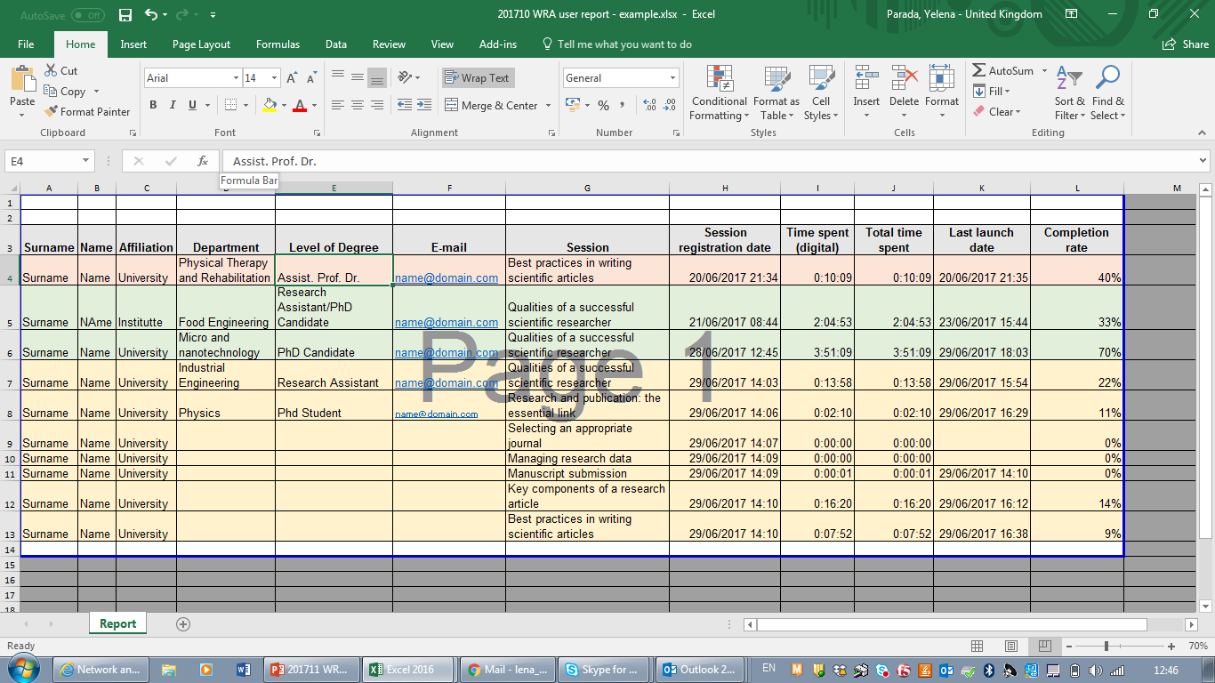
Detailed reporting

Slide 45
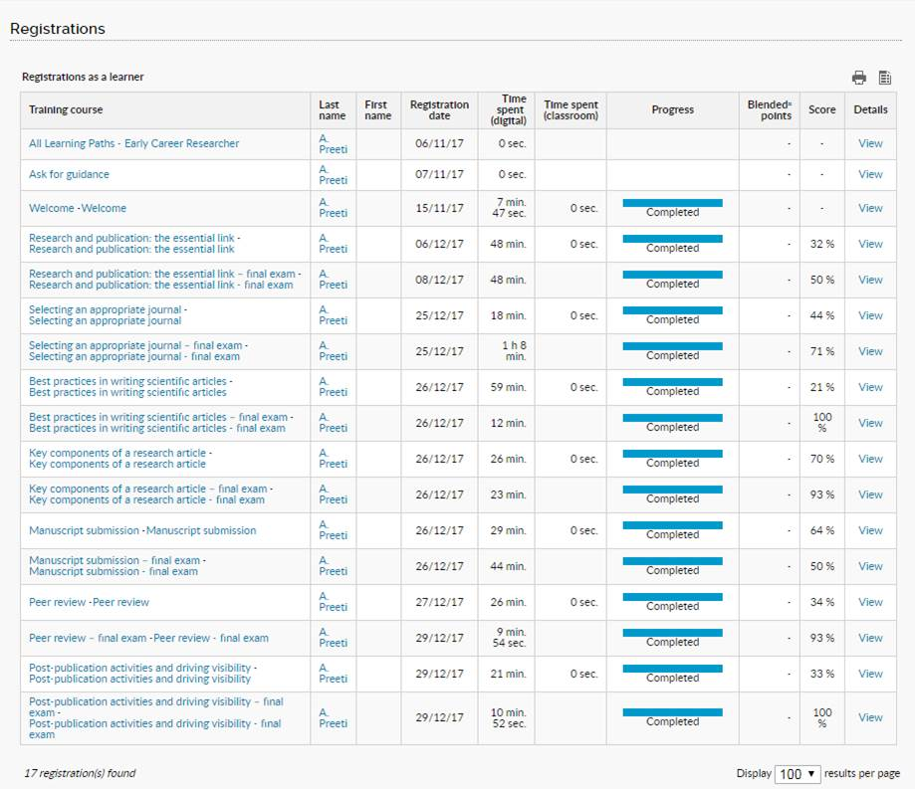
Sample single-user usage and performance data

Slide 46

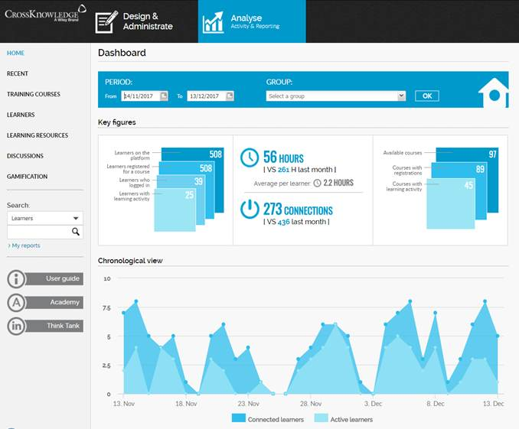
Effective measurement and reporting
Dashboards and configurable reports
Monitor usage, completion and learning benefits by institution, level of study, subject group, etc.
Insight into researchers’ strengths and weaknesses

Slide 47



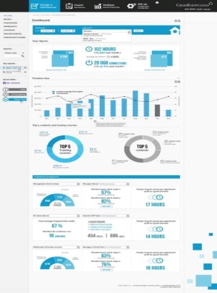
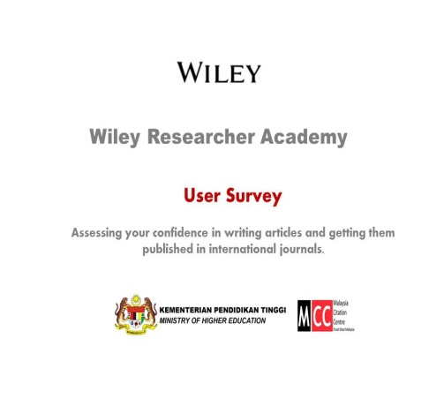
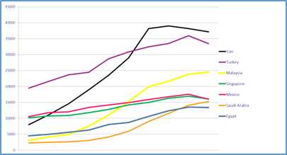


Measuring efficacy for national customers
Participation
Demonstrated improvement
Learner confidence levels
Increase in scientific outputs
+
+
+
Usage and completion rates
Pre- and post-training assessment
Measurement of post-training confidence in completing publishing tasks
Longer term, increase in the number of articles accepted by international journals

Slide 48



National Programme Value Proposition
Content
Learning
Access
Efficiency
Community
Strategy
14 courses over 50 hours
Instructional design
Scalable, cost efficient
Online community for researchers
New insights into researcher skills
National licence
Most scholarly and complete
Knowledge and competencies
Eliminate duplication, waste
Participation and live events
Drive research outputs
Unlimited academic
users
Impartial
Self-paced
Wiley project management
Wiley Excellence Recognition
Increase impact and collaboration
All target cohorts
Social learning
Reports and dashboards
Updating commitment
Drive economic performance
3 year licence
National certified programme
Measurable outcomes
Coverage of national themes
Peer-to-peer mentoring
Benefit society
Learn and return
New networks
Continuous improvement
Customisable
Learning and reference

Slide 49
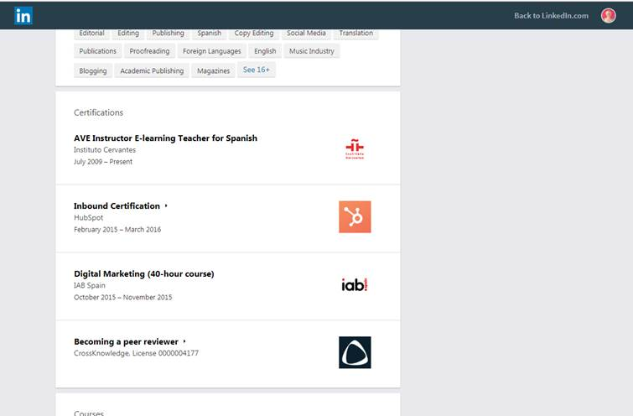
Sample certification on LinkedIn

Slide 50

Benefits of the WRA
For Early-career Researchers
(grad students, postdocs, junior faculty, advanced undergrads)
Learn (and avoid!) the common mistakes in manuscript preparation and submission to ensure the fastest route to publication
Know the best ways to identify predatory publishers/journals
Be able to promote your published work most effectively
Earn certificates of completion that indicate your level of training in scholarly publishing

Slide 51
Benefits of the WRA
For Faculty
Save time in training students about scholarly publishing
Have confidence that your students will be able to avoid common “rookie publishing mistakes”
Save time getting your students’ manuscripts published
Be able to track student learning with usage and performance reports
For Institutions
Faculty and students recognize that the parent institution is investing in their professional development and success
Providing this training demonstrates intentional action toward fulfilling strategic goals for growth in research output
Be able to create reports that show institution-wide learning and progress.

Slide 52
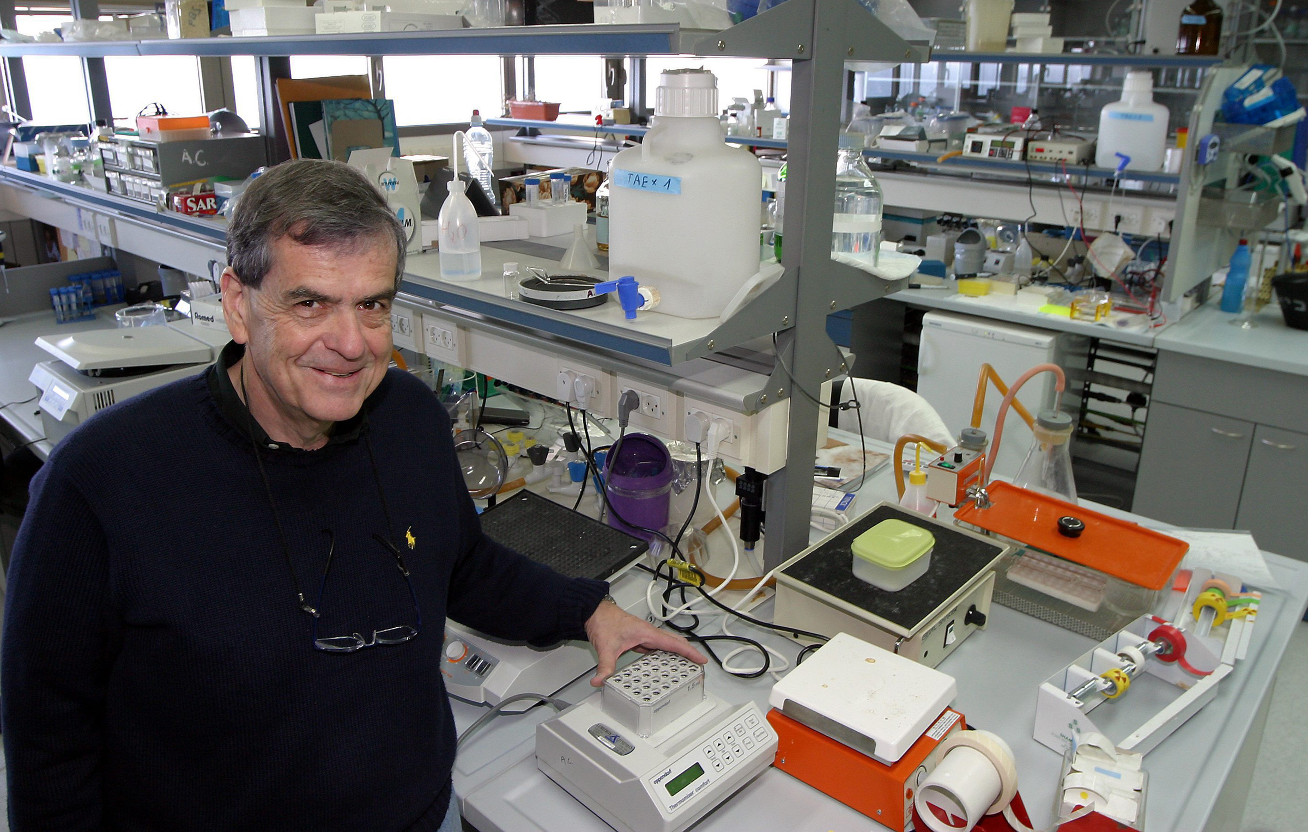
"Getting educated and trained in the skills one needs in order to publish research results, hypotheses, and models has never been more important, in particular for young scientists, but also for the more established among us:
Wiley has taken an important initiative in developing an online platform that provides that education and assesses participants’ progress. There is no doubt it will help scientists increase the impact of their studies.“
Professor Aaron Ciechanover
Nobel Prize, Chemistry 2004
Notes:
Pronounced chee-HAHN-oh-veer. Won the Nobel in chemistry for his work on the ubiquitin pathways for recycling proteins.

Slide 53
“I think especially nowadays with so much research as well as the new metrics, it’s essential for researchers to take this or a similar course”
“I think it’s an excellent program. Excellent.”
(Wiley Researcher Academy, Market Research report – June 2017)

Slide 54



Curriculum customization
Implementation Plan
Integration into technical infrastructure
Incorporation of national content modules
Incorporation of national speakers
Identification of monitoring and data needs
Configuration of dashboards and reports
Certification
Alignment to national system for STI
Identification of performance indicators
Project Manager
Training of administrators and end users
Linking participation to future publishing performance
Special initiatives to drive usage and completion rates
Live events
Technical support 24/7
User surveys
Wiley Excellence Recognition Programme
Learner Relationship Management configuration
Quarterly performance reports

Slide 55

Partnership with Wiley to drive continued growth in the quality and quantity of Russian published research outputs and stimulate international collaboration in science.

Slide 56
Main Differentiators to Competition
Competition are offering a superficial resource compared with our WRA (e.g. no testing structure and little in the way of multimedia and exposure to a variety of expert speakers), and very publisher-centric in its coverage of resources... A big advantage of WRA is that it’s publisher agnostic (neutral).
Amongst our WRA key elements are the calibre of contributors, the interactive formats (vs long monotonous ppts) and the neutrality indeed.
All the Learning Paths can be exported as SCORM connectors, which can be easily imported in the institution’s LMS.
Most competitors lack the facilitator feature (allows mentoring), gamification or have limited social features (allows networking).
Certifications are common in competitors, and in high demand. However, our WRA certifications can moreover be provided on both an LP level (exportable to LinkedIn as they make progress) and at the end of the program (customized with logo and name of the institution that makes it a requirement).
Reports are perceived as one of our unique differentiators compared to the competition. Facilitators, who can act as mentors, can also access their analytics at any point seamlessly through the learners ‘interface.
The key aspect of the WRA app is the offline access to content.
Facilitators, and how to set up faculty to lead courses in a blended fashion, or add their own materials. We can make it so that we have multiple facilitators with different areas of expertise monitoring several LPs within the same institution, for a really granular customized experience.
In terms of WRA customization, we can create several versions of the WRA for one single institution, dedicated to its different schools (medical vs SSH), or its different groups, like faculty vs researchers, etc. adding different logos, names and including info on their school policies in the courses.

Slide 57
QUESTIONS AND DISCUSSION
What kind of publishing assistance services are already available for your early-career researchers?
Who at your institute would be stakeholders in providing publishing training to students and faculty?
Professional development (for students and faculty)
Library
Student/postdoc trial or sponsored event?

Slide 58
Questions
Next steps
Free Trials
Thank you
Reinhard Schuelke
rschuelk@wiley.com
http://news.wiley.com/wileyresearcheracademy

